Slide 1



Latest BEM developments
and
The microwave and sub-millimetre database
December 2020
Antigoni Kleanthous, University College London, UK
Timo Betcke, University College London, UK
David Hewett, University College London, UK
Anthony Baran, The Met Office, UK & University of Hertfordshire, UK

Slide 2
Part I: Accelerated Calderón preconditioning for Maxwell transmission problems
Antigoni Kleanthous, University College London, UK
Timo Betcke, University College London, UK
David Hewett, University College London, UK
Paul Escapil-Inchauspé, Universidad Adolfo Ibáñez, Santiago, Chile
Carlos Jerez-Hanckes, Pontificia Universidad Católica de Chile, Santiago, Chile
Anthony Baran, The Met Office, UK & University of Hertfordshire, UK

Slide 3
The Boundary Element Method (BEM)
Reformulate the problem into boundary integral equations on the boundary of the scatterer
Discretise the boundary and transform the boundary integral equations into a matrix system
Solve the discrete problem on the boundary using an iterative solver
The solution on the boundary can be extended to the interior/exterior/far field area through representation formulae

Slide 4
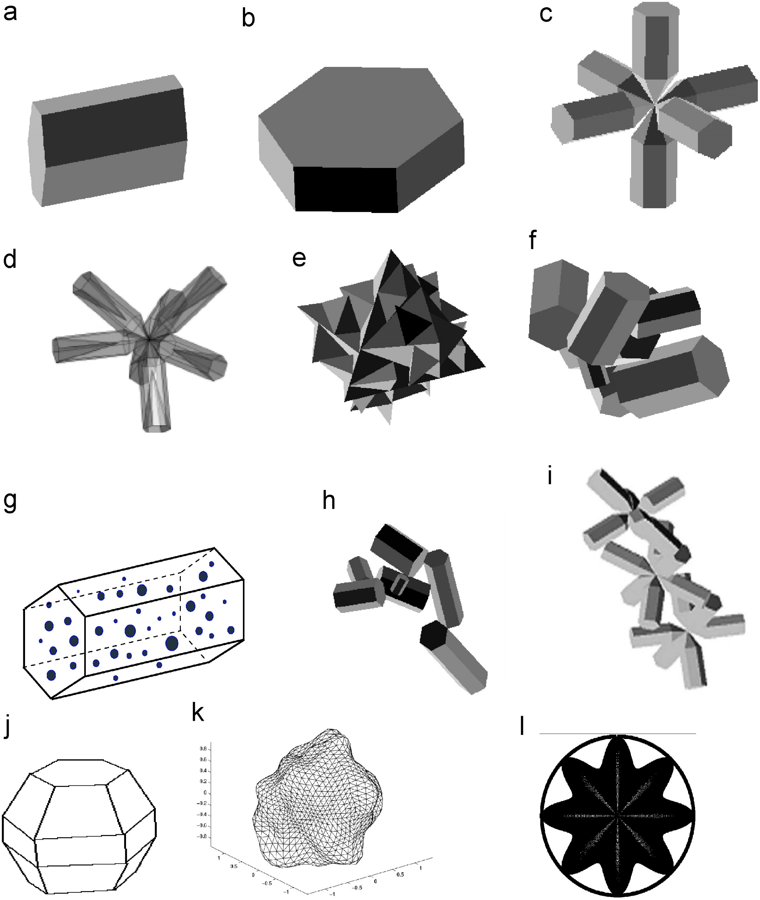
Why use BEM?
Reduces the dimensionality of the problem from a 3D domain to a 2D manifold
Discretisation is easier/faster
The matrix system is smaller
Radiation conditions at infinity automatically satisfied
Can solve the full time-harmonic Maxwell problem without the need for any approximations
Can handle complicated domains – ideal for complex shaped ice crystals

Slide 5
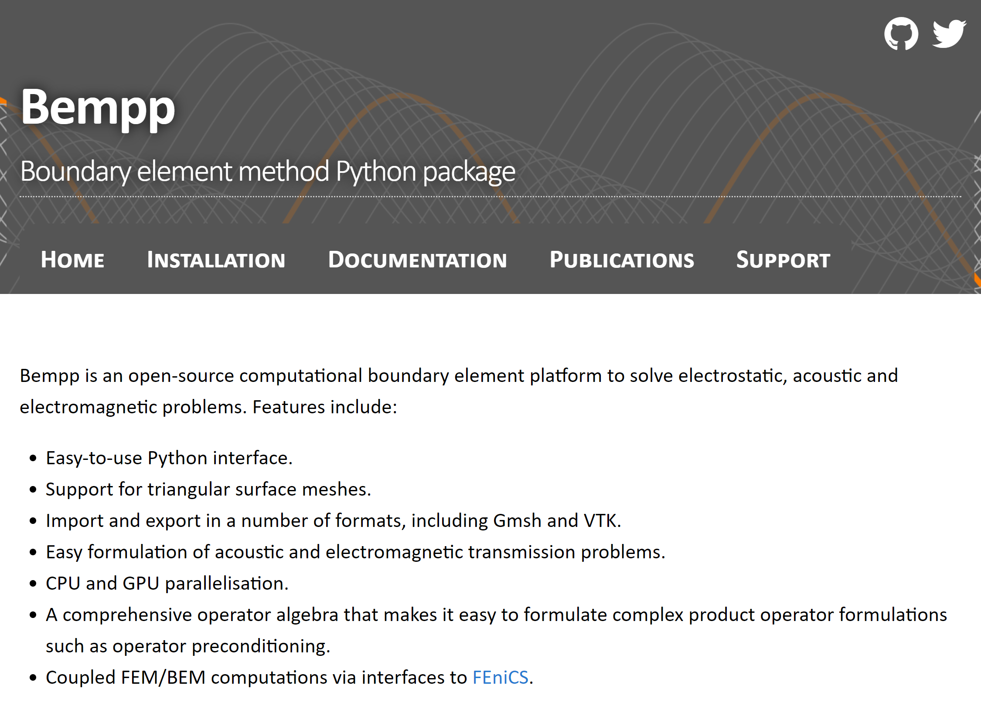

Slide 6
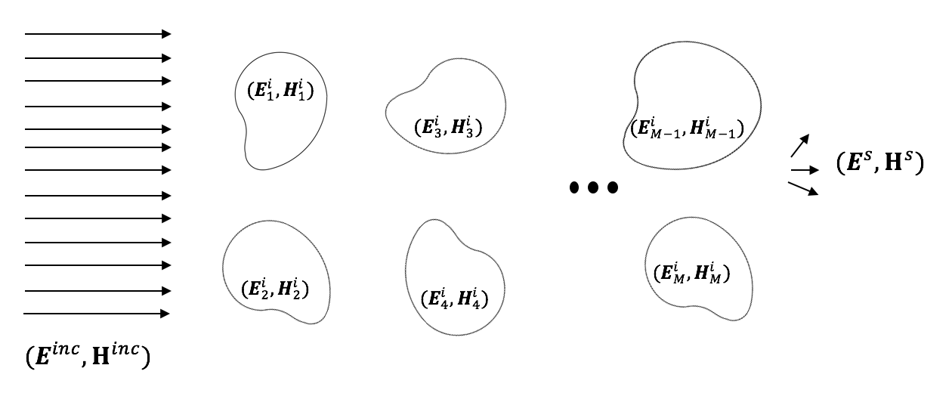
The scattering problem

Slide 7
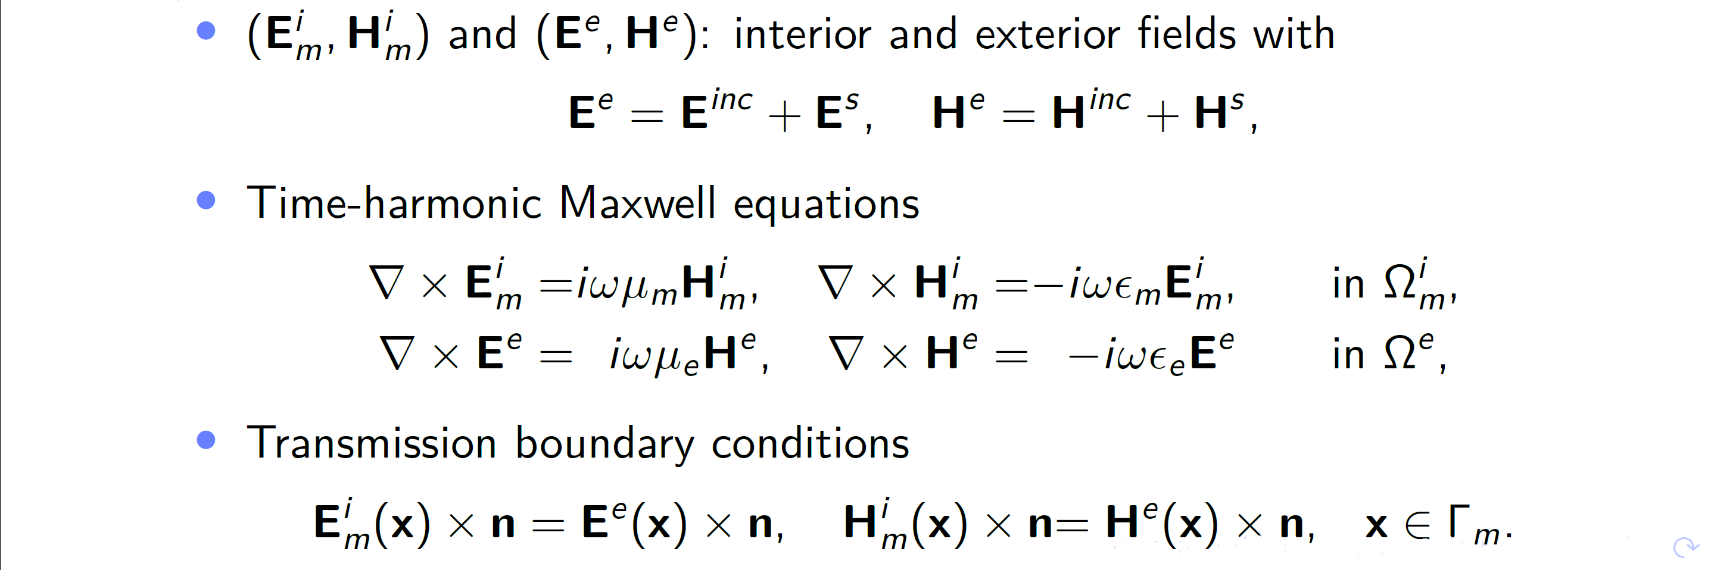
The scattering problem

Slide 8
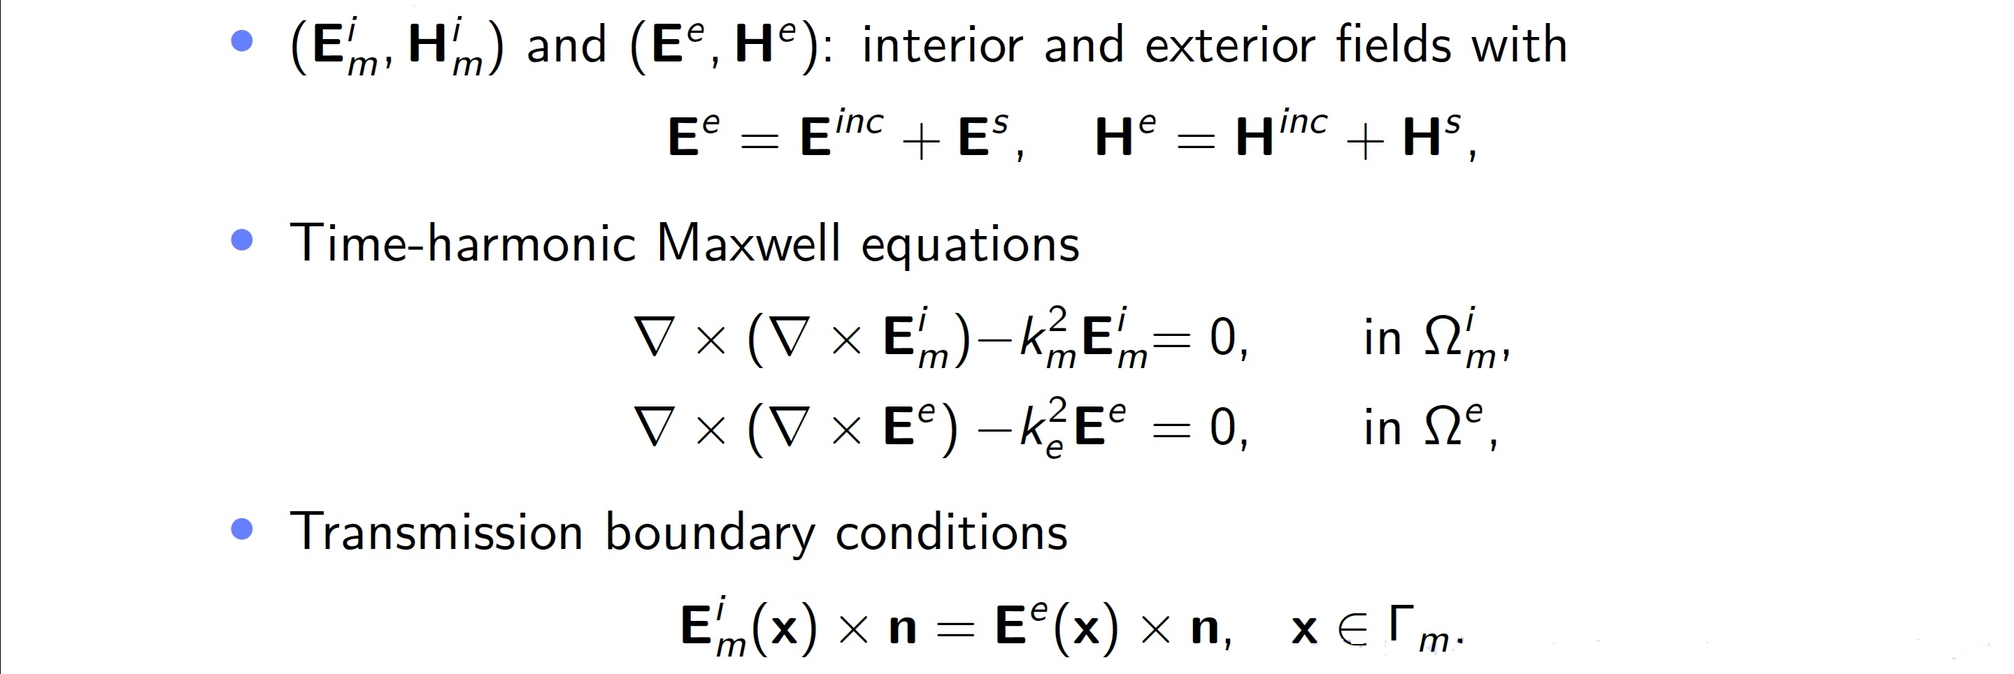
The scattering problem

Slide 9
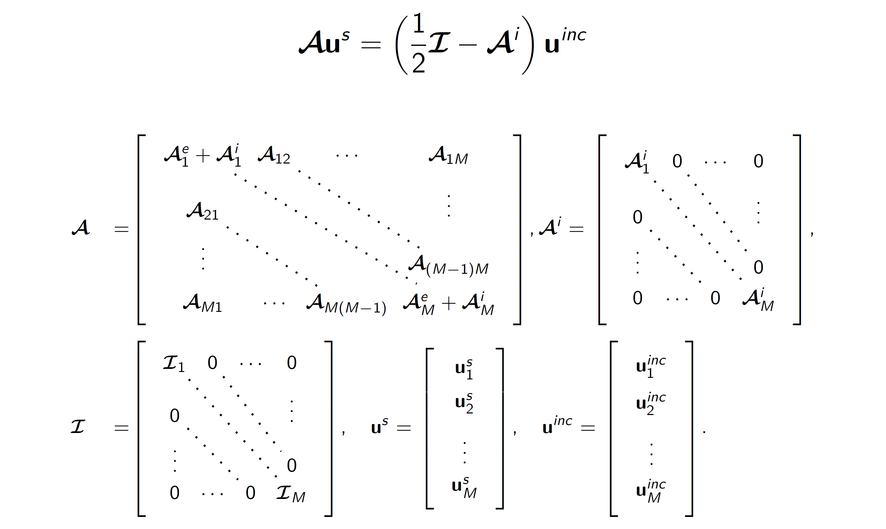
The PMCHWT formulation

Slide 10
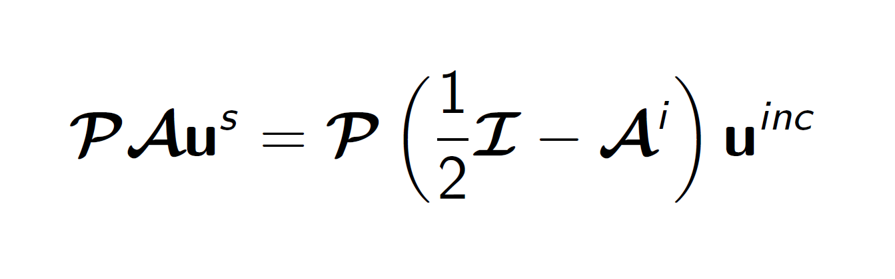
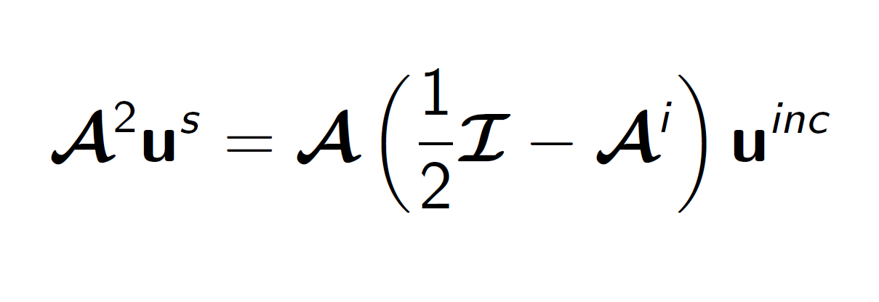
Calderón Preconditioning

Slide 11
Accelerated Preconditioning
To accurately capture the wave solution a mesh refinement of 10 elements per wavelength is usually used
To stably discretise the operator product PA, the use of a dual mesh is required. The dual mesh is defined on the barycentrically refined original mesh leading to a 6-fold increase in the number of elements
Applications have been limited to relatively small size parameters due to memory and time constraints.
Accelerating techniques to reduce memory and assembly time

Slide 12
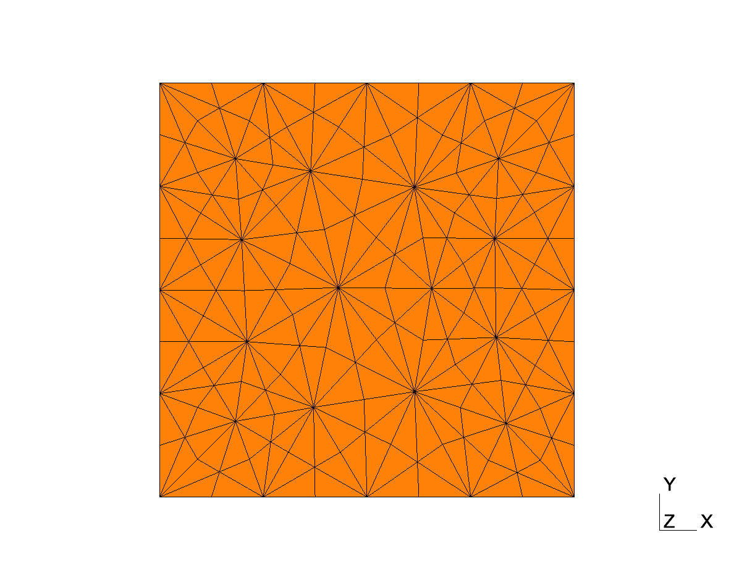
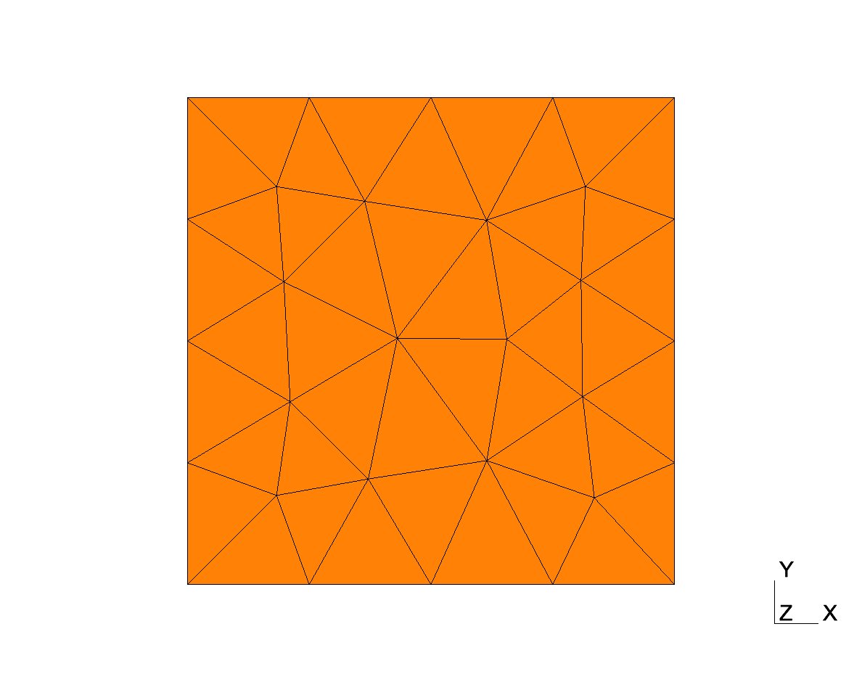
Accelerated Preconditioning
To accurately capture the wave solution a mesh refinement of 10 elements per wavelength is usually used
To stably discretise the operator product PA, the use of a dual mesh is required. The dual mesh is defined on the barycentrically refined original mesh leading to a 6-fold increase in the number of elements
Applications have been limited to relatively small size parameters due to memory and time constraints.
Accelerating techniques to reduce memory and assembly time

Slide 13
Accelerated Preconditioning
To accurately capture the wave solution a mesh refinement of 10 elements per wavelength is usually used
To stably discretise the operator product PA, the use of a dual mesh is required. The dual mesh is defined on the barycentrically refined original mesh leading to a 6-fold increase in the number of elements
Applications have been limited to relatively small size parameters due to memory and time constraints.
Accelerating techniques to reduce memory and assembly time

Slide 14
Accelerated Preconditioning

Slide 15
Accelerated Preconditioning: operator-based approach
Goal: Reduce number of operators used in the preconditioner
A reduced preconditioner has a weakened preconditioning effect – balance between memory/assembly time savings and solver time

Slide 16
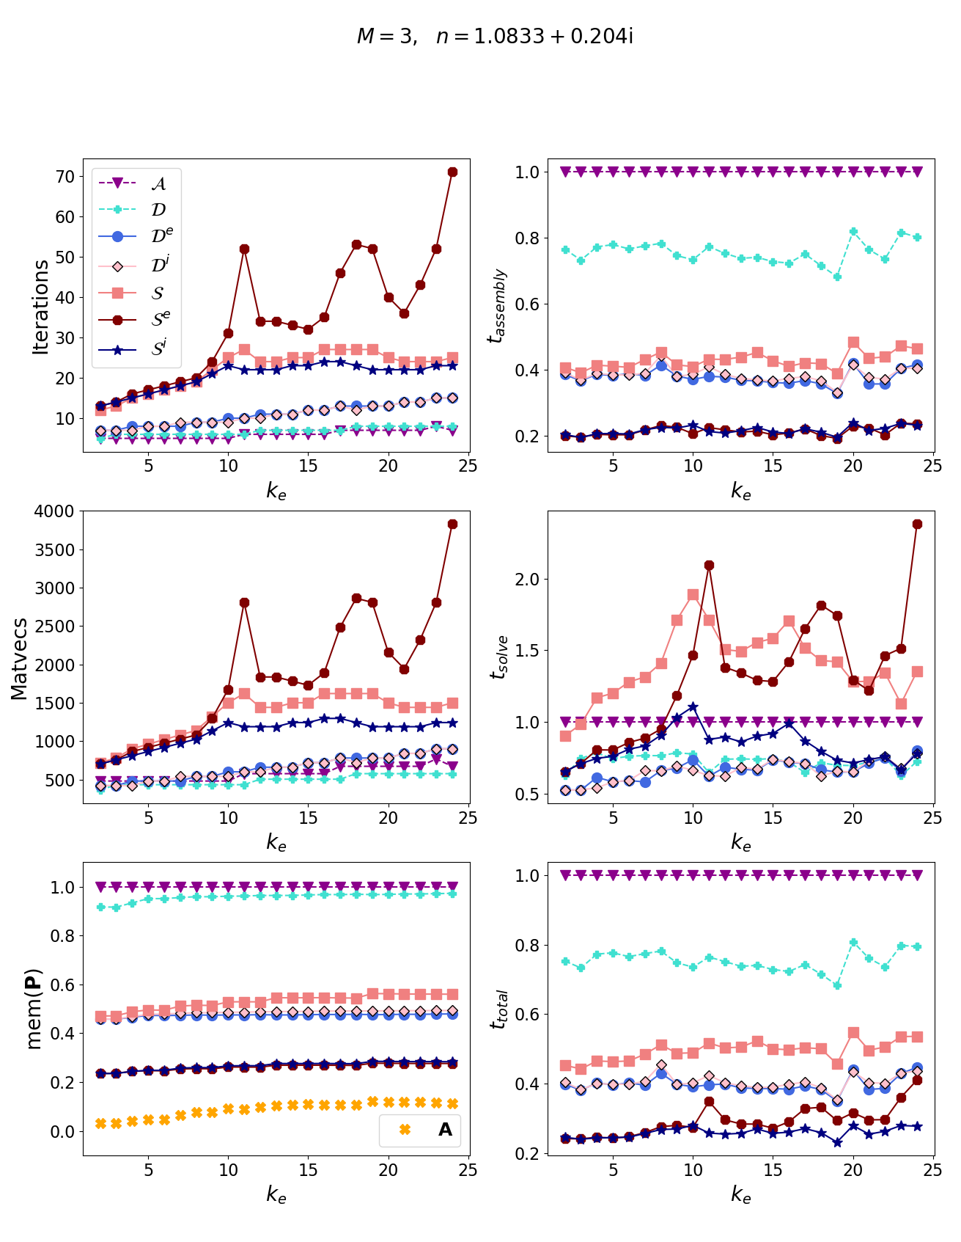


Slide 17
Accelerated Preconditioning: implementation
Use a relaxed set of parameters for the preconditioner; the preconditioner is used to accelerate solution time – accuracy is not affected

Slide 18
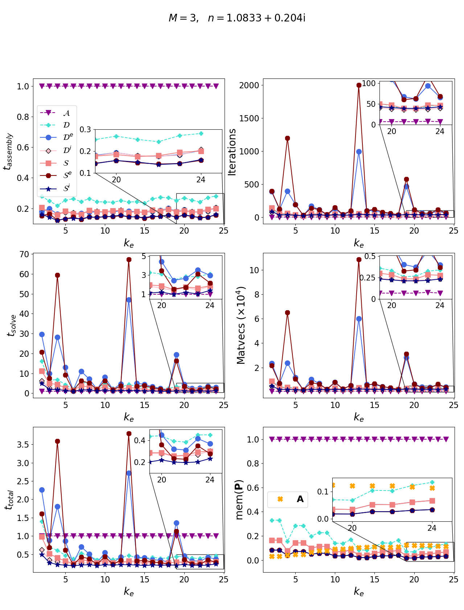

Slide 19
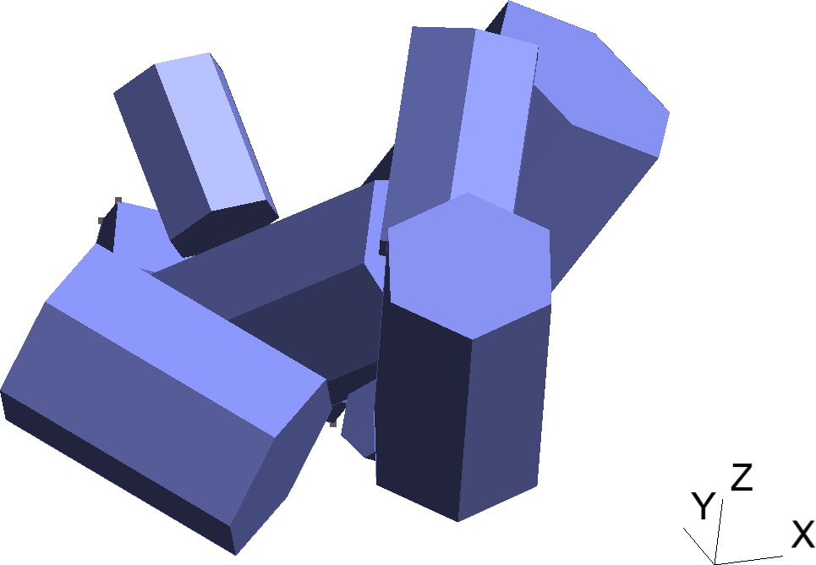
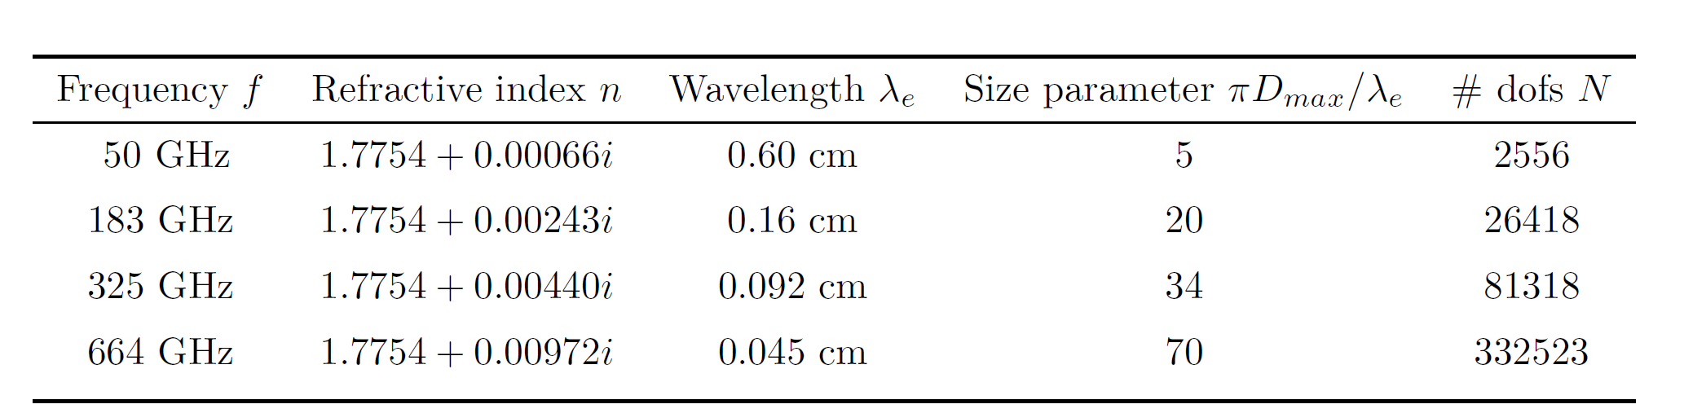
Accelerated Preconditioning

Slide 20
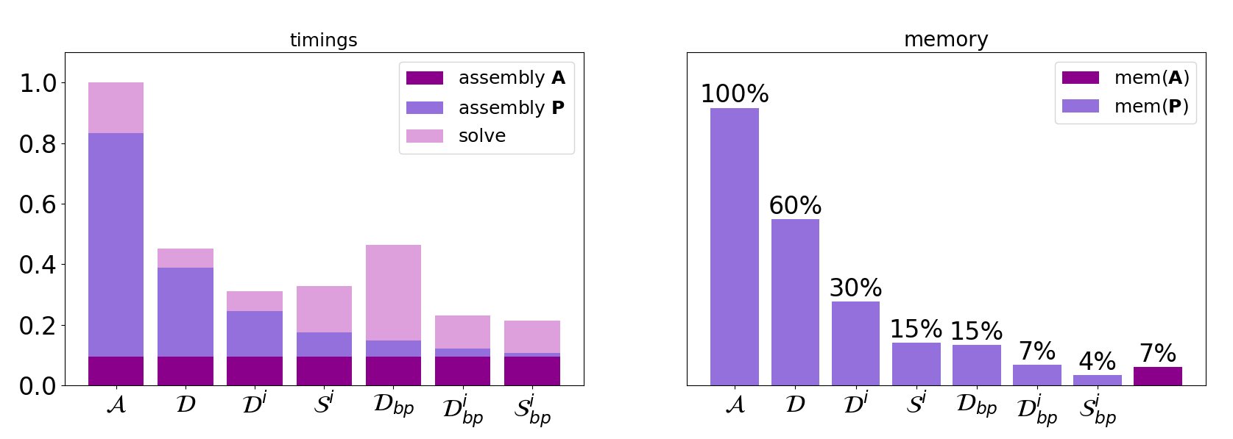
Accelerated Preconditioning – 50GHz

Slide 21
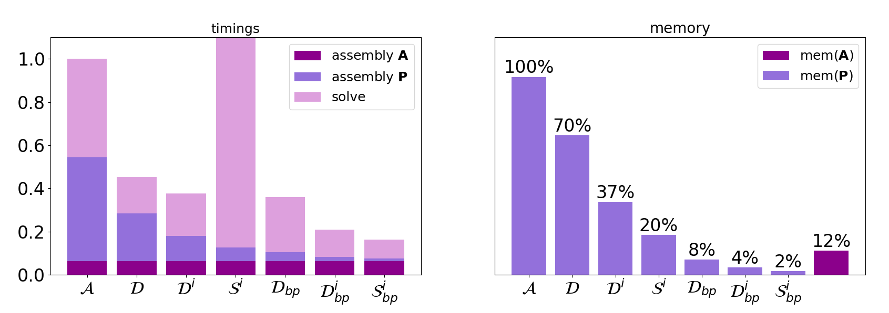
Accelerated Preconditioning – 183GHz

Slide 22
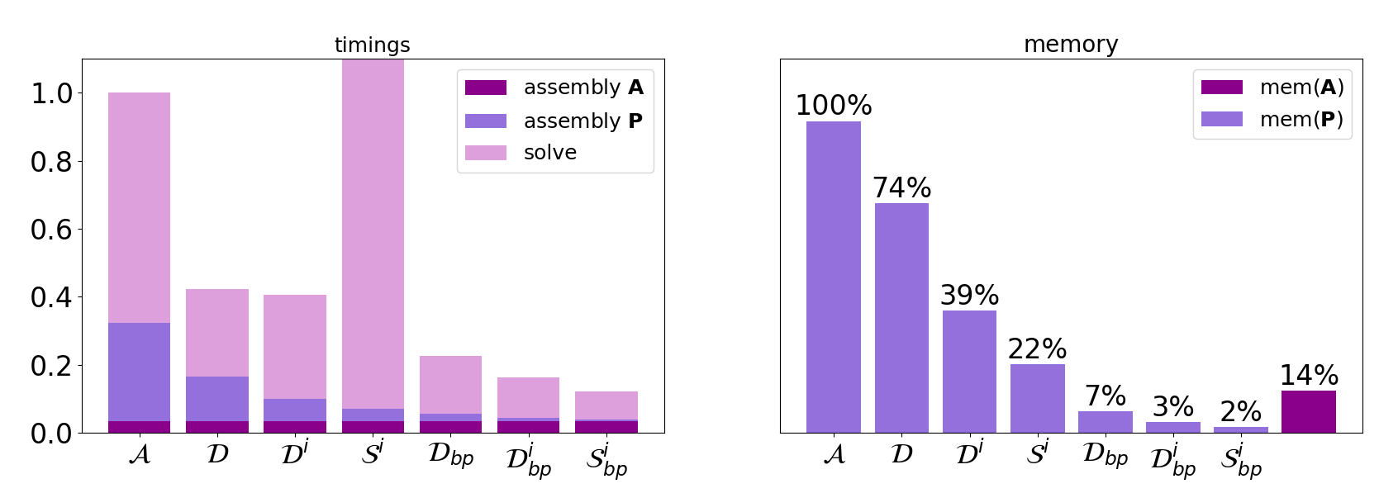
Accelerated Preconditioning – 325GHz

Slide 23
Accelerated Preconditioning – 664GHz
Unable to assemble the matrices except for S^{i}_{bp}
Assembly time:
10 minutes for the preconditioner
32 minutes for the operator
GMRES time:
62 minutes
166 iterations
Memory:
9GB for preconditioner – estimated to be ~1-2% of the original non-accelerated version
109GB for operator

Slide 24
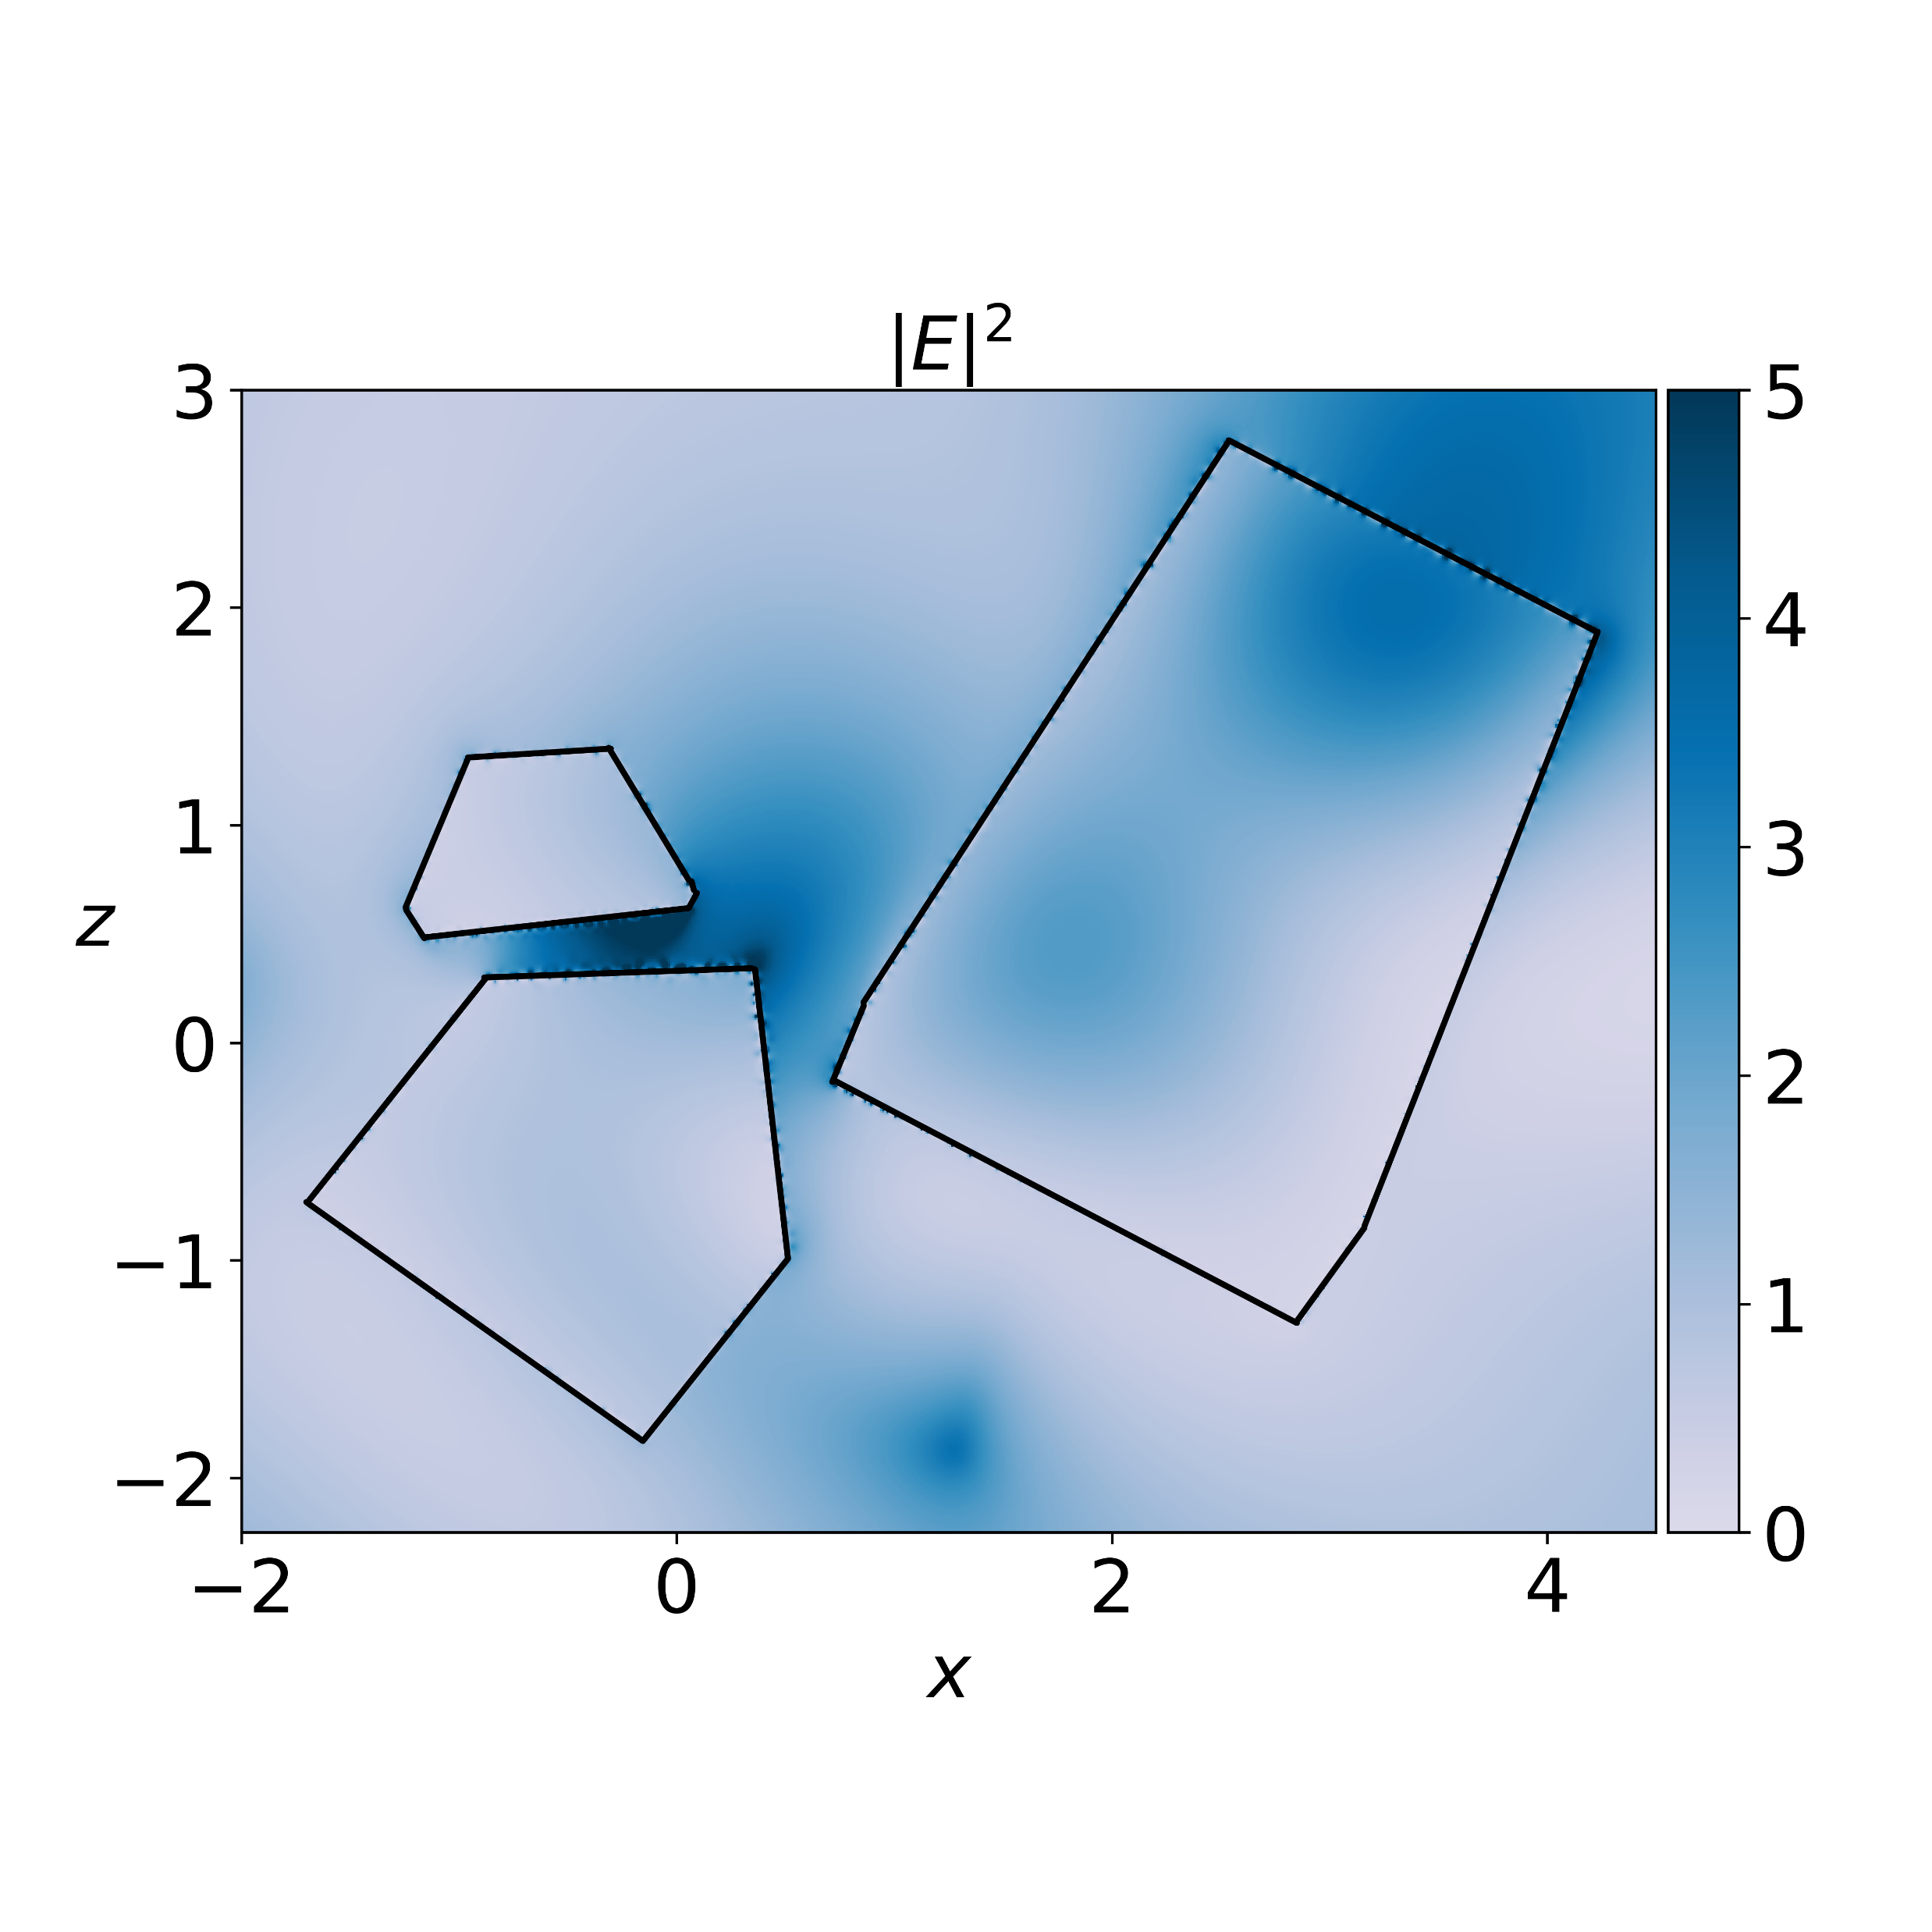
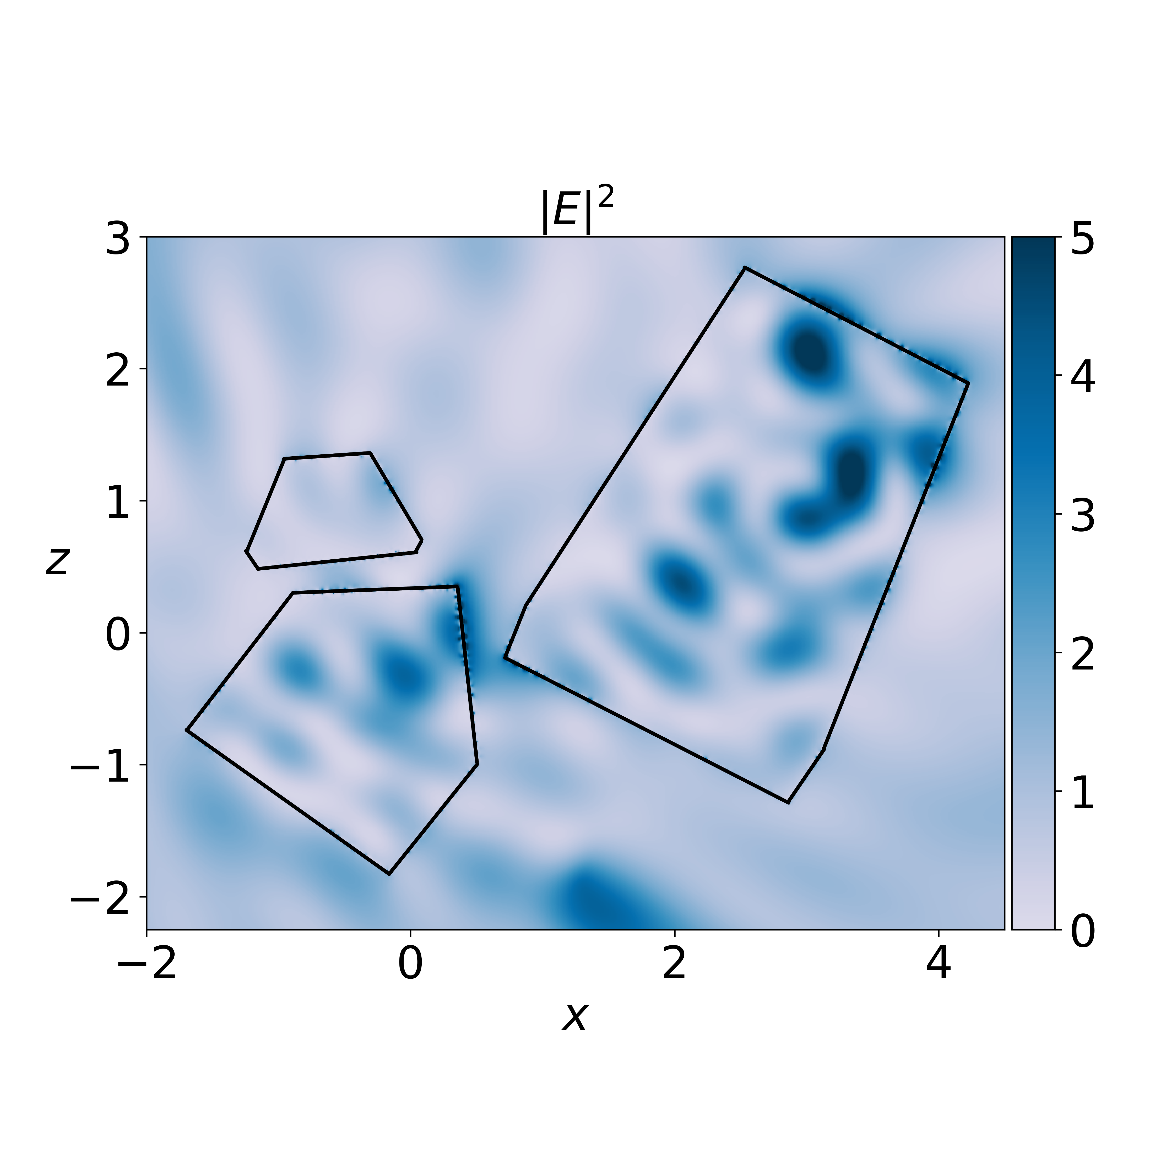
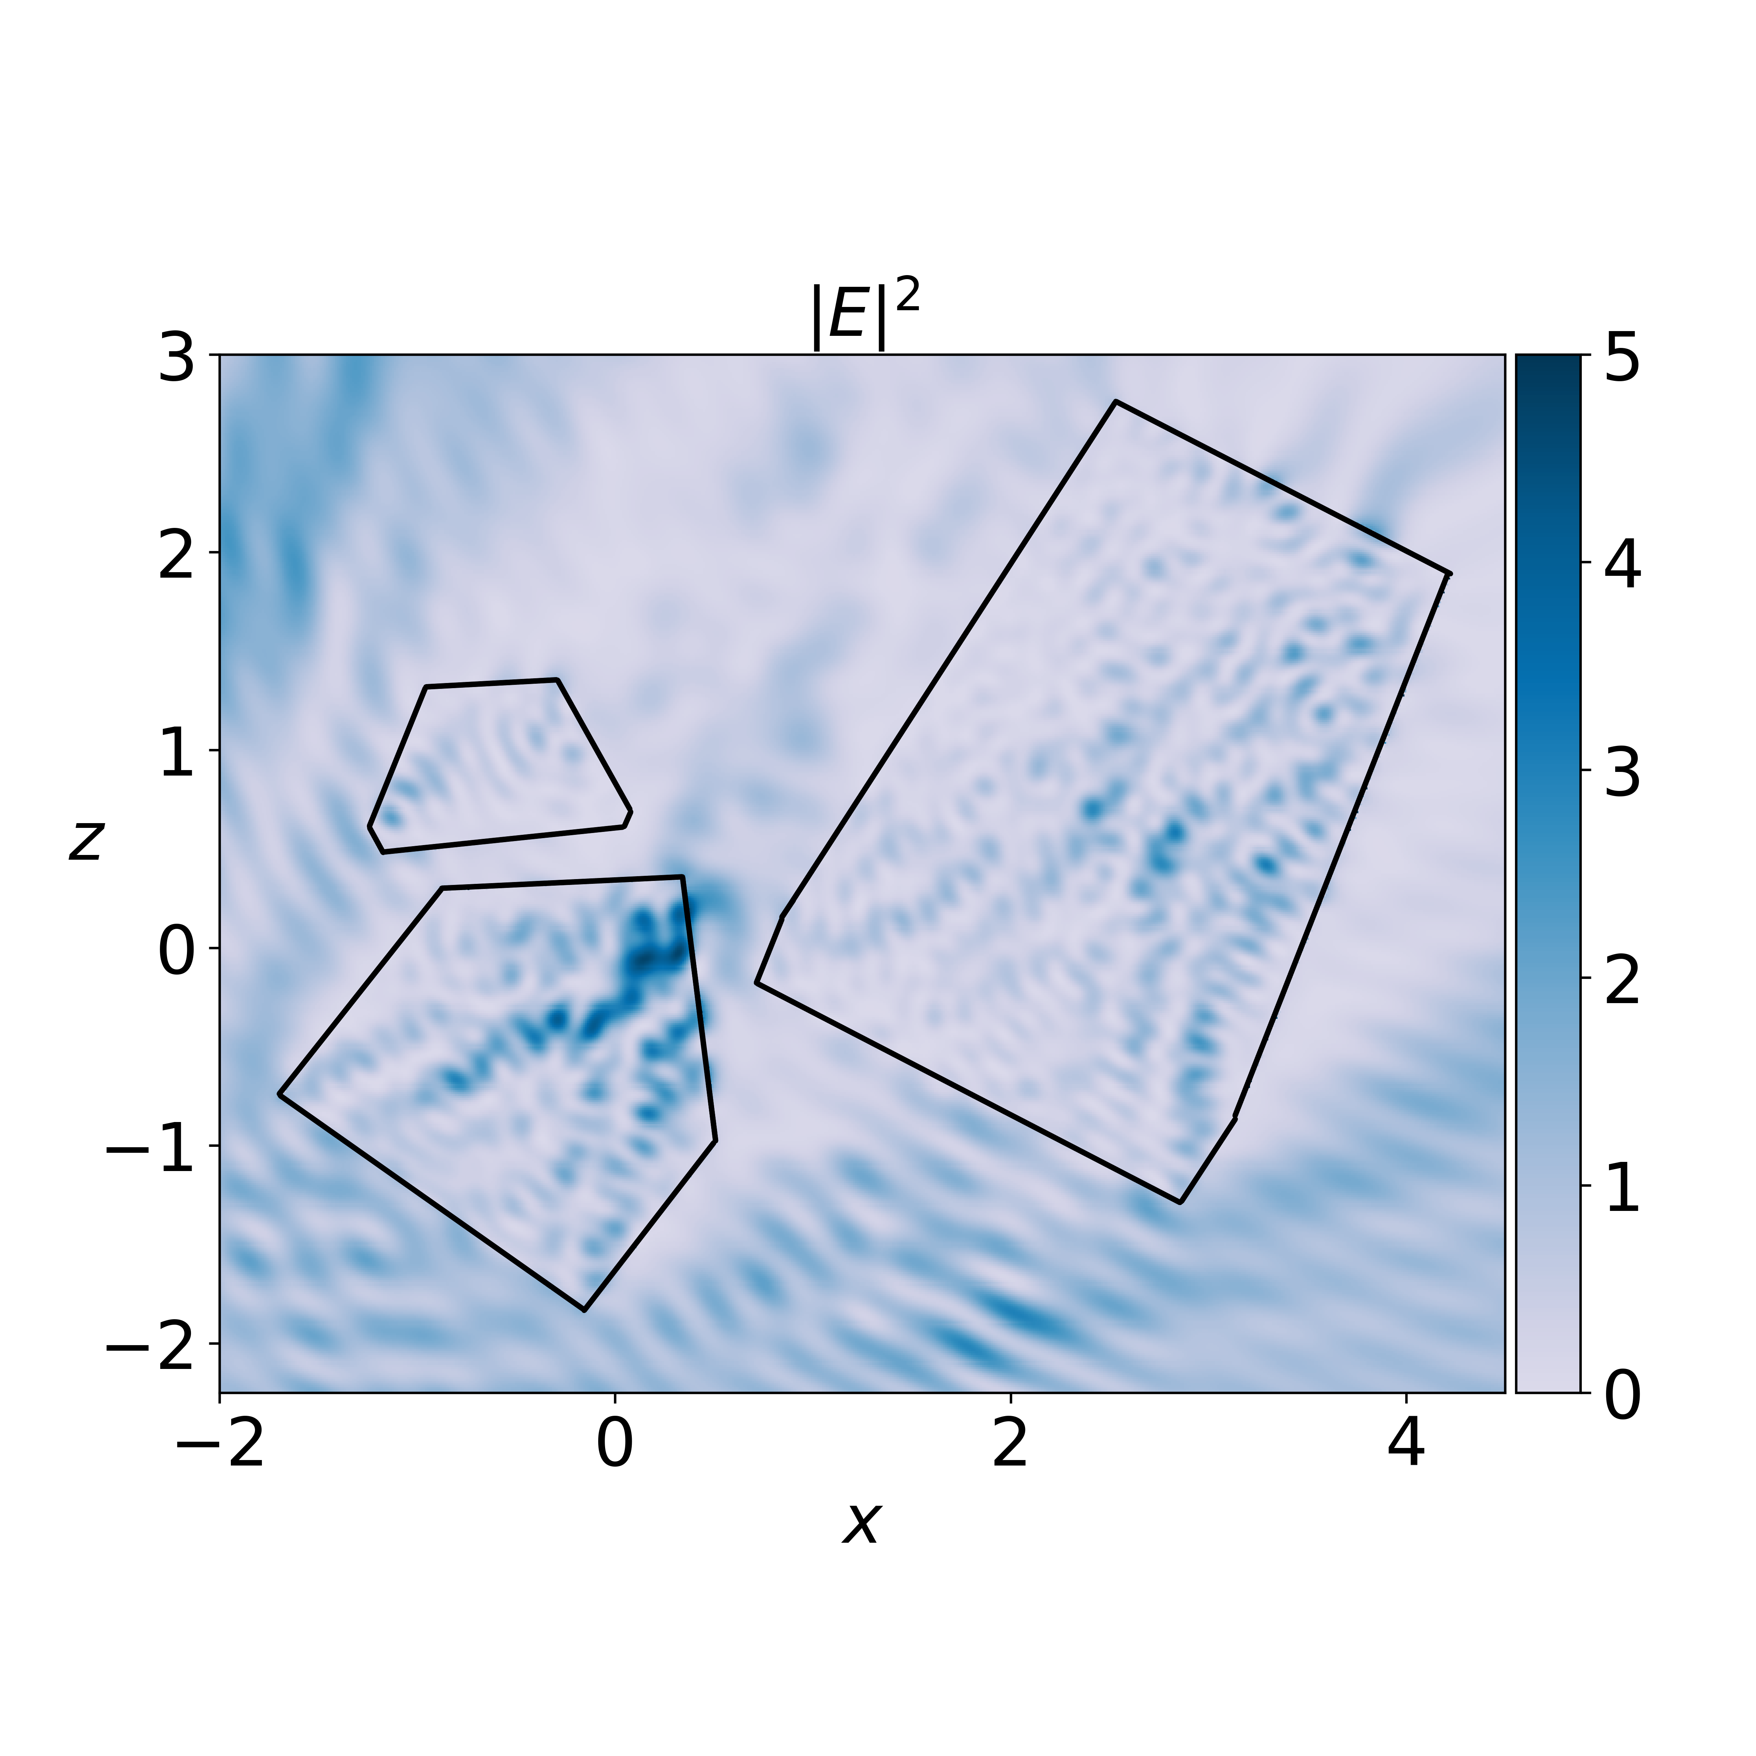
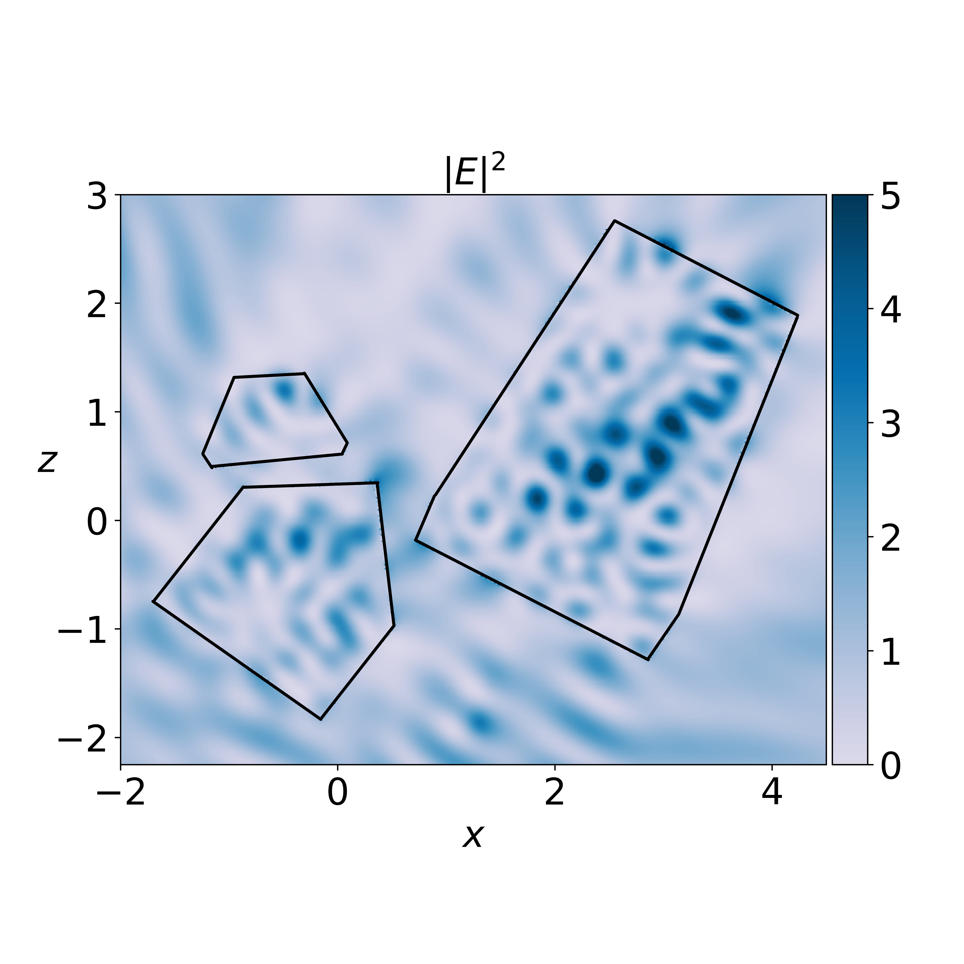

Slide 25
Part II: Using accelerated BEM for a microwave and sub-millimetre database
Antigoni Kleanthous, University College London, UK
Timo Betcke, University College London, UK
David Hewett, University College London, UK
Anthony Baran, The Met Office, UK & University of Hertfordshire, UK
Chris Westbrook, University of Reading, UK

Slide 26
The database
Goal: simulate SSPs and phase matrices of budding rosettes and aggregates of bullet rosettes in random orientation
5 temperatures: 190K, 210K, 230K, 250K, 270K
4 frequencies: 50GHz, 183GHz, 243GHz and 664GHz
Range of sizes from μm to cm

Slide 27
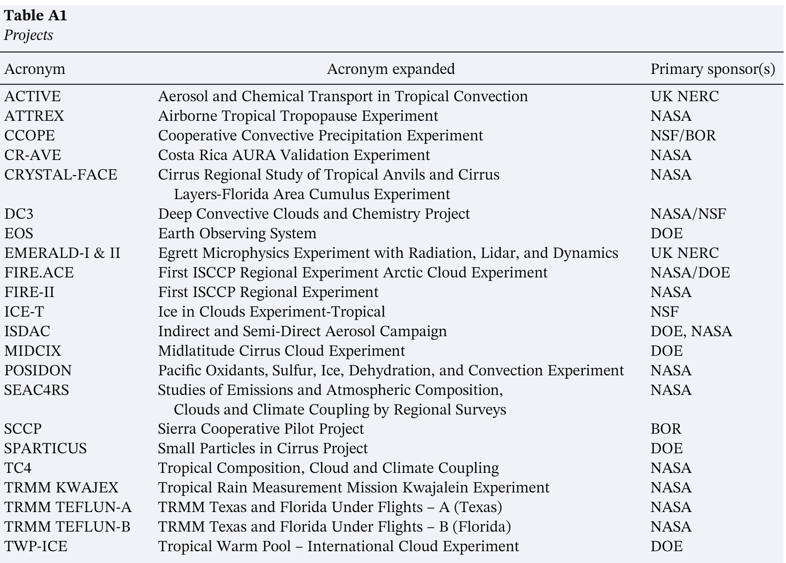
The microphysical model
Notes:
analysis of more than 100 images from Cloud Particle Imager (CPI) data from twenty-two campaigns distributed throughout the mid-latitudes, tropics, and southern latitudes

Slide 28
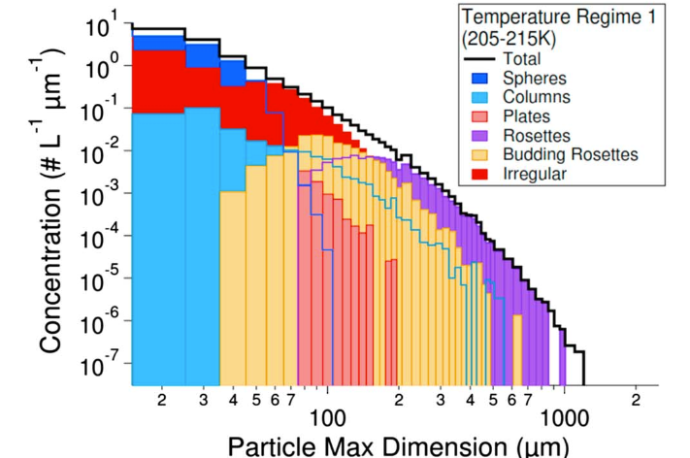
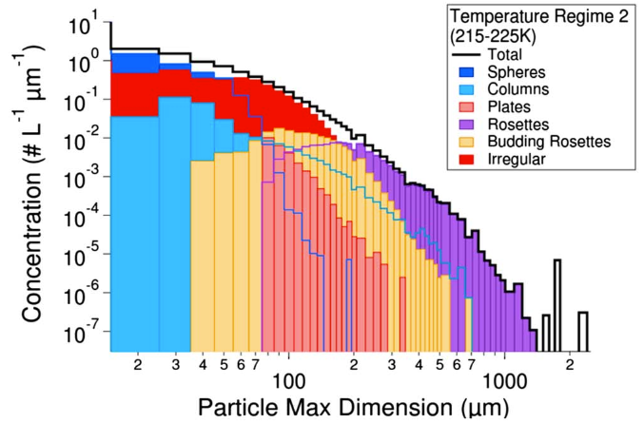
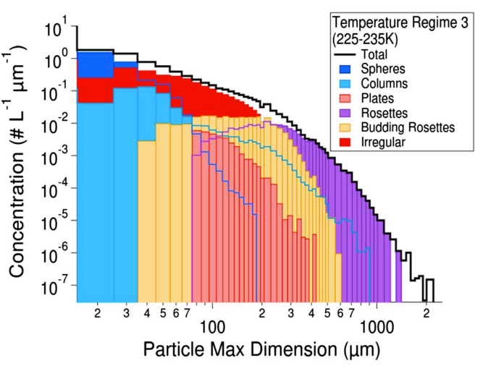
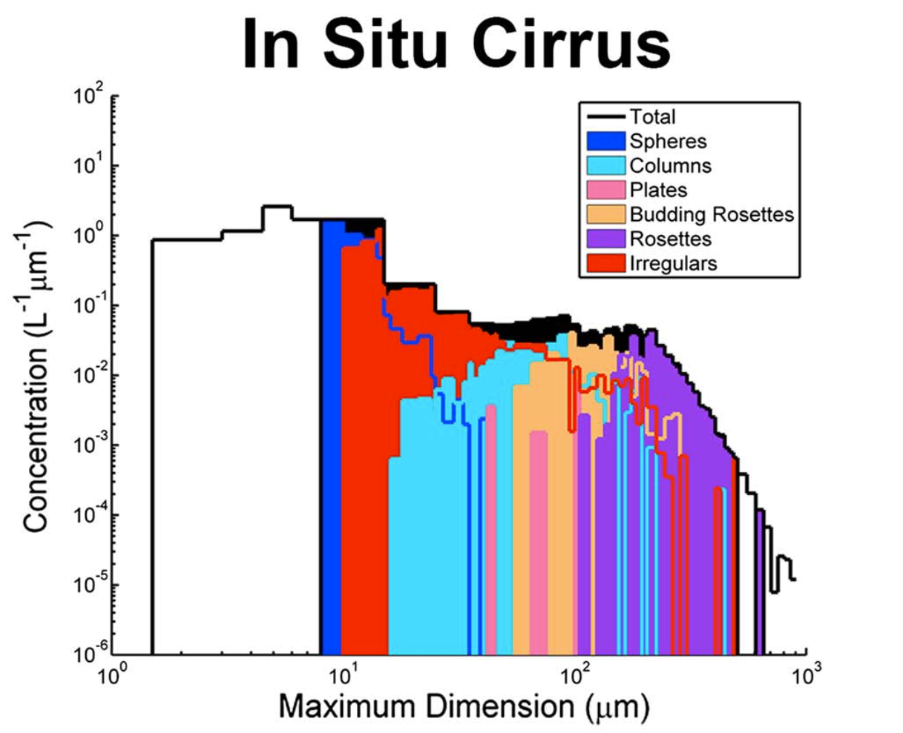
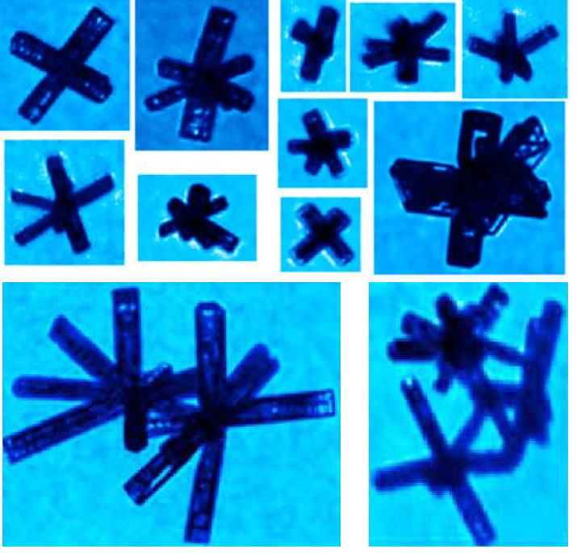
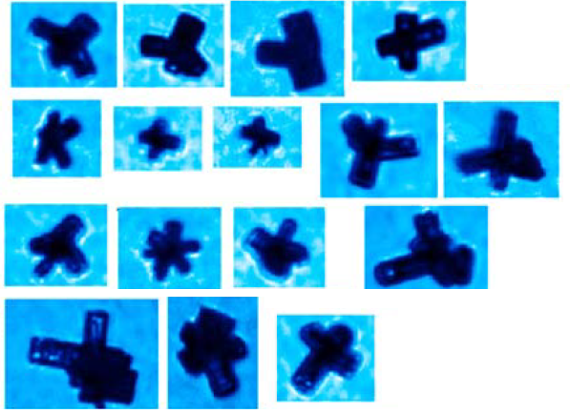
The microphysical model
Notes:
From that analysis, the most representative ice crystal shapes of relevance to modelling millimetre wave and sub-millimetre wave scattering within in-situ generated cirrus (prevalent in the mid-latitudes) are budding rosettes and aggregates of rosettes, which we use to generate our ensemble model.

Slide 29
The microphysical model
The aggregates were generated using the ice aggregation model of (Westbrook, et al., 2004) formed by Monte Carlo simulations
The monomer rosettes are constructed of three-branched rosettes, which are aggregated together to follow the Cotton et al. mass–dimension relationship – to be consistent with the Unified Model used at the Met Office
Each of the monomers that makes up the ensemble of rosette aggregates is assumed to have the density of solid ice, 917 kg/m³
The final model consists of 65 aggregates, of maximum dimension between 10 and 10,000μm.

Slide 30
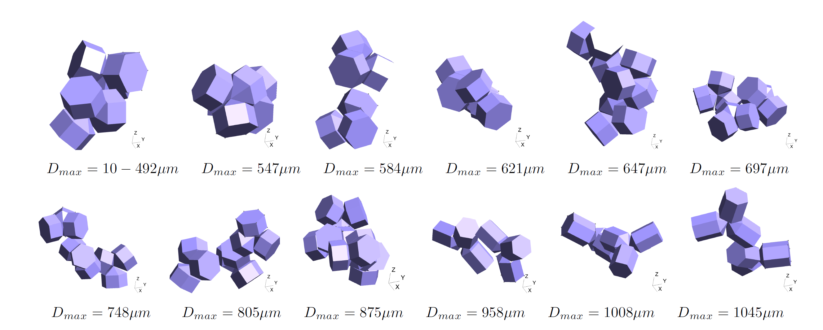
The microphysical model
Notes:
At sizes between 10-492 μm the rosette aggregate is scaled, and so is invariant with respect to its maximum dimension up until 492 μm. The remaining aggregates are all different as they are from different realisations of the Monte Carlo simulations. The aggregates consist of 6 to 168 monomers of different complexity.

Slide 31
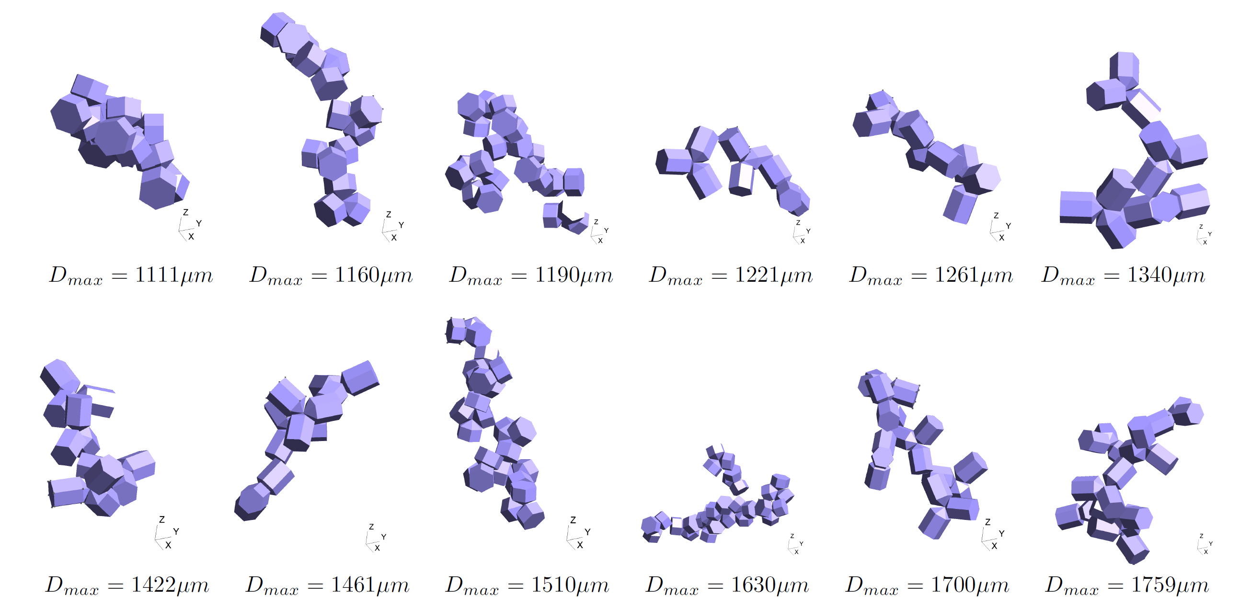
The microphysical model

Slide 32
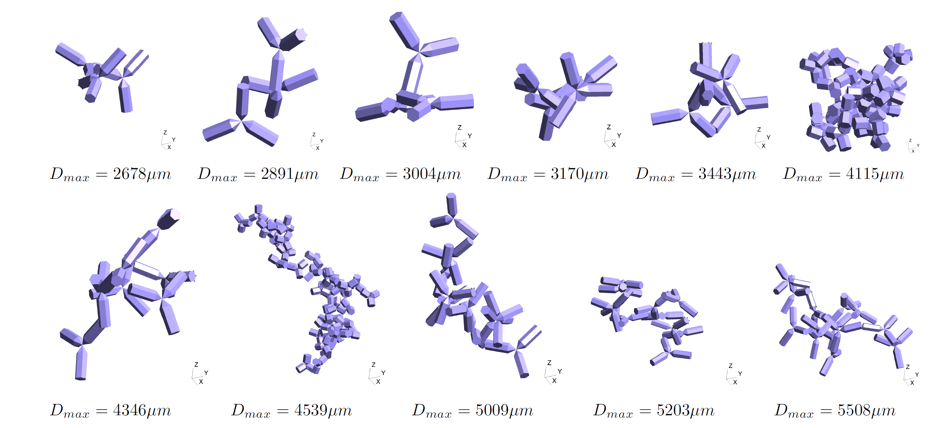
The microphysical model

Slide 33
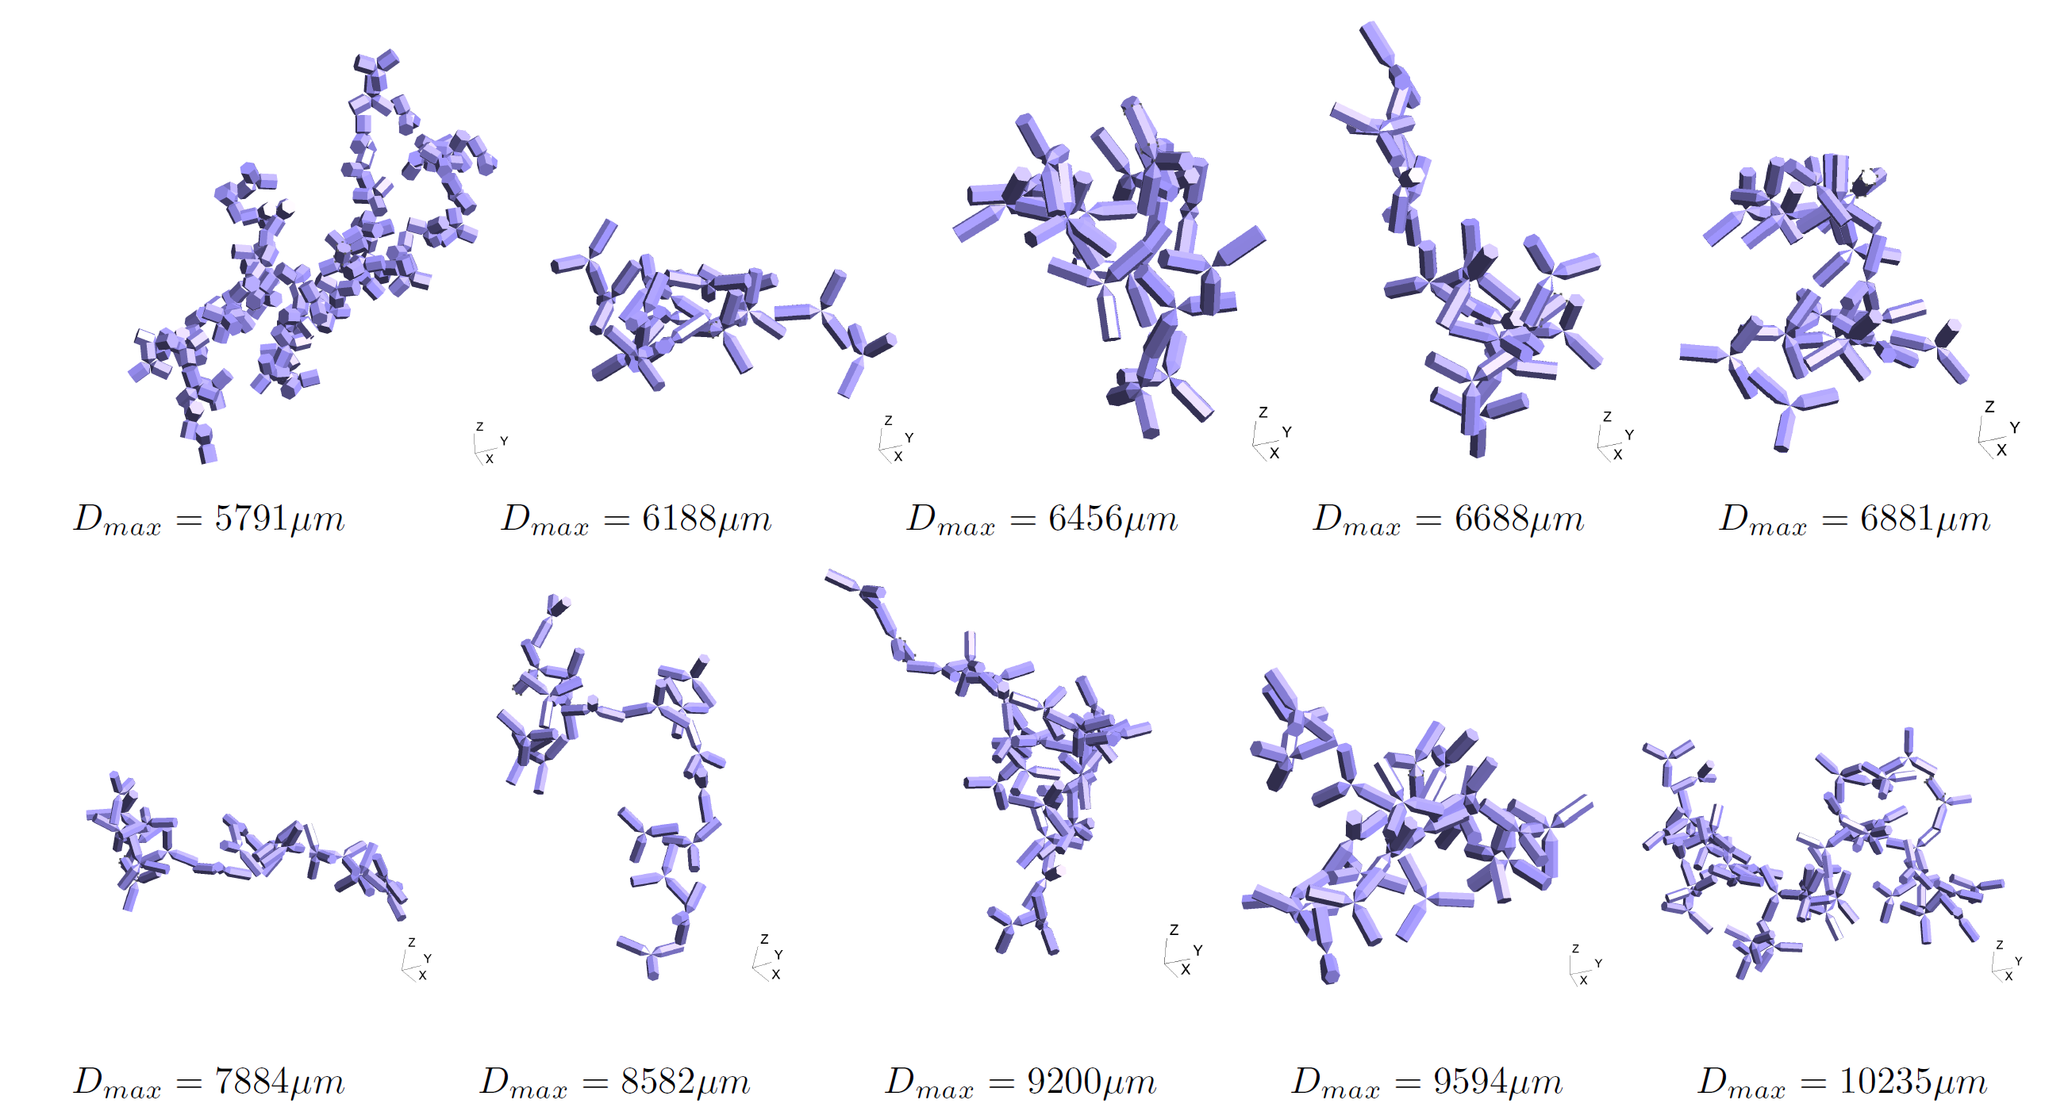
The microphysical model

Slide 34
Simulating random orientation
The orientation average of some quantity is evaluated by a triple integral over the three Euler angles used to describe the orientation of a body
The traditional approach to achieve this is to fix the direction of the incident wave, and then rotate the particle in three directions via the three Euler angles. The SSPs and phase matrix are then evaluated for some scattering angles.

Slide 35
Simulating random orientation
The traditional approach would be too expensive to follow using BEM: each rotation requires the assembly of a new matrix operator and preconditioner.
Fixing the direction of the incident wave and rotating the scatterer by the appropriate rotation matrix is equivalent to fixing the orientation of the scatterer and instead rotating the direction and polarisation vectors of the incident wave by the inverse rotation matrix.
This enables us to assemble the operator matrix and preconditioner once and re-use for all incident wave solutions. By using appropriate quadrature schemes suitable for numerical integration over a sphere our integration scheme reduces to only 2 loops; a combination of Lebedev and Gaussian quadrature.
In addition, the different incoming waves are distributed over different CPUs to accelerate solution even further.

Slide 36
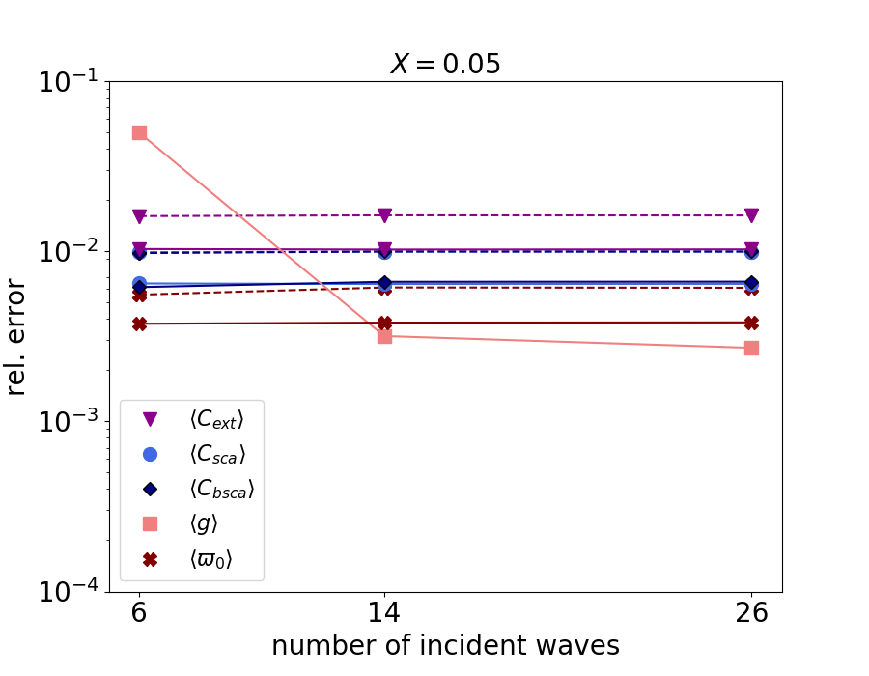
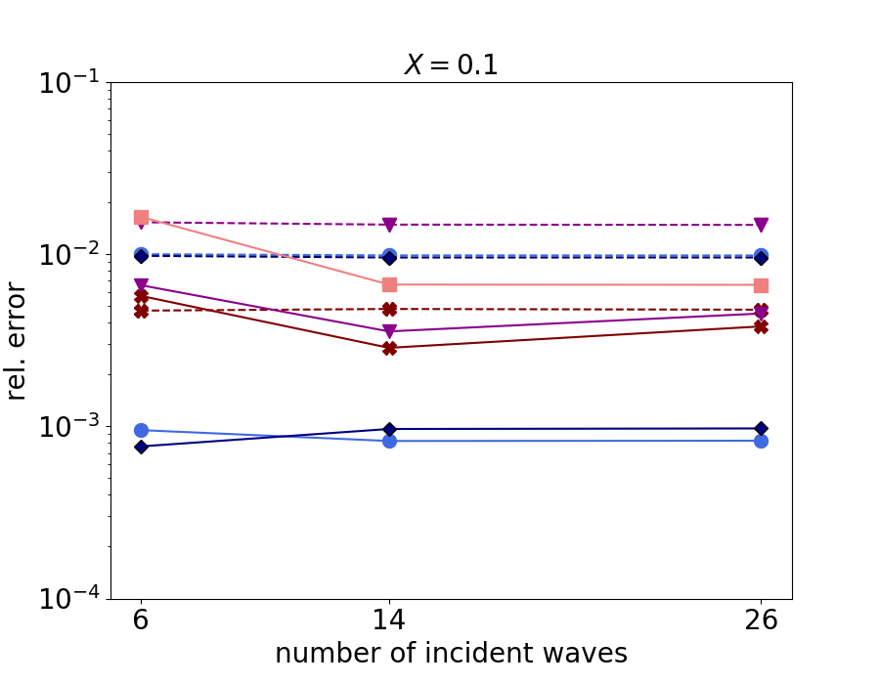
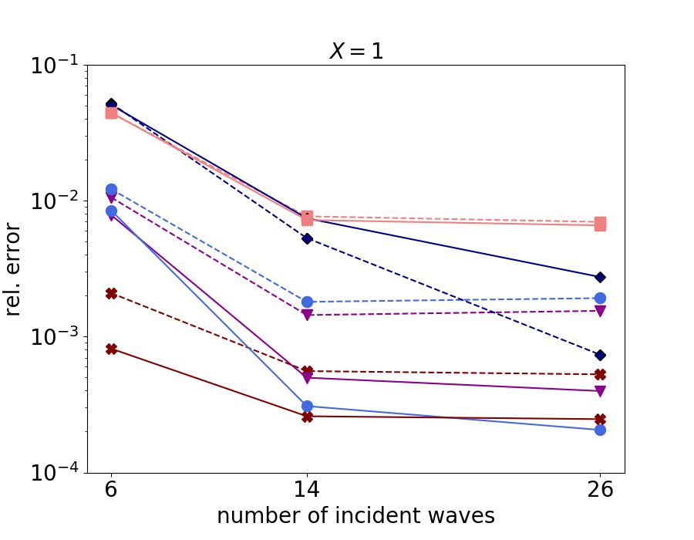
Testing our method
Notes:
Solid lines: refined mesh

Slide 37
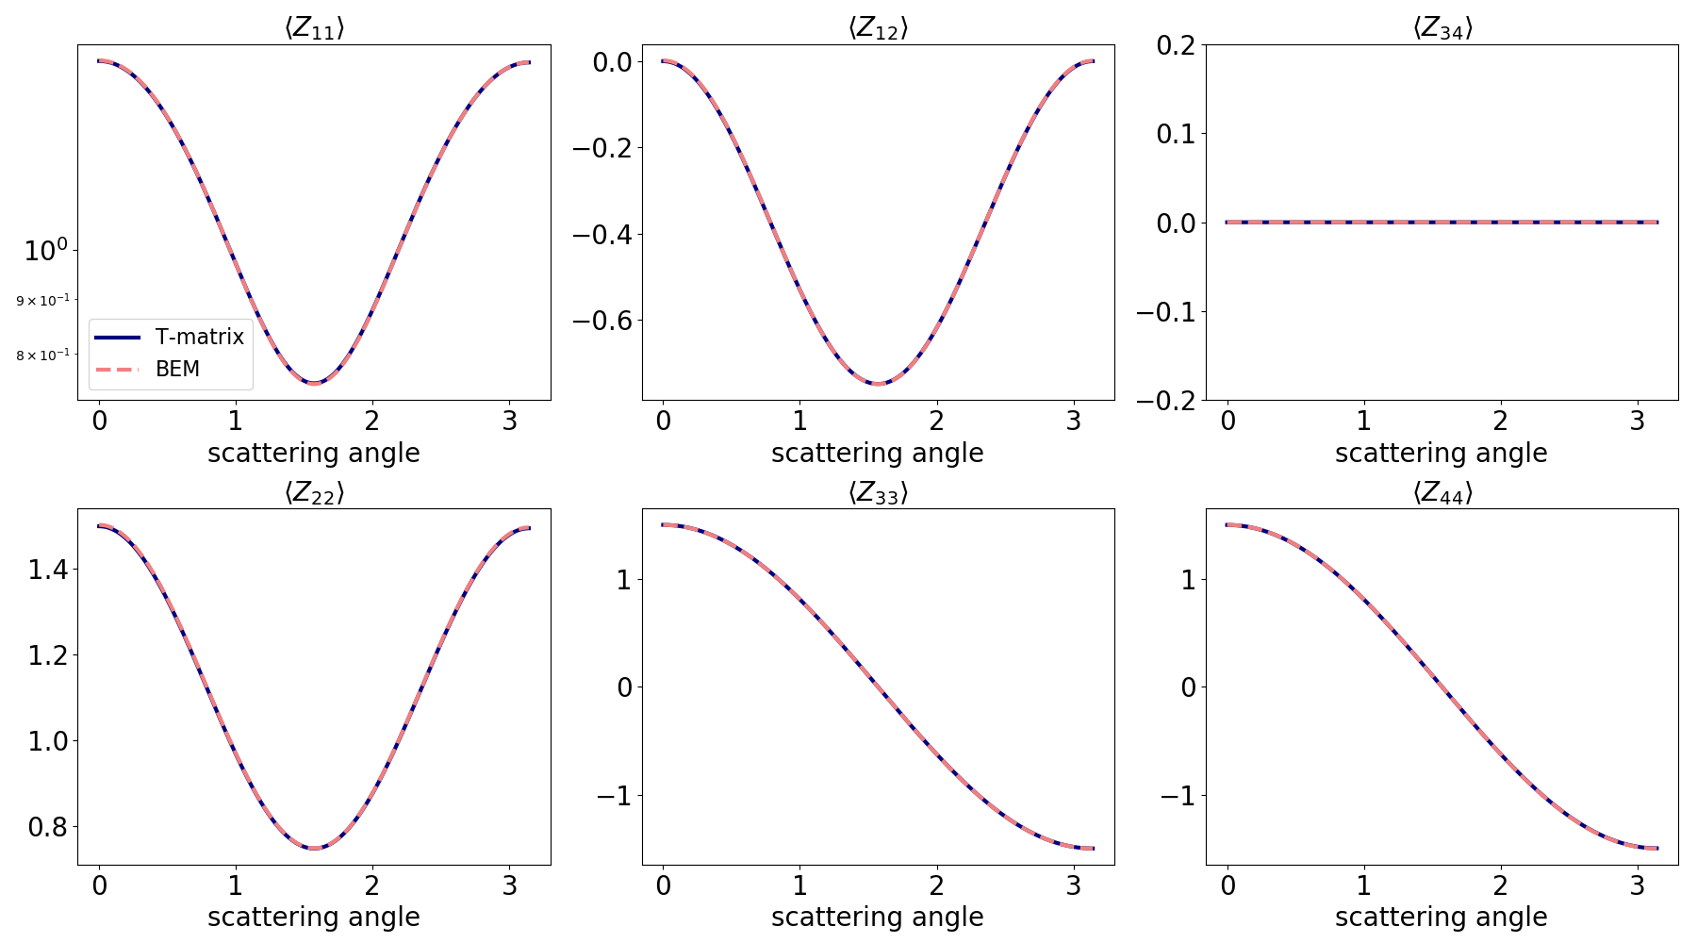
Testing our method – X=0.05
Notes:
X=0.05
Mesh of 100 elements per wavelength
6 incident waves
5 rotations of the polarisation vectors

Slide 38
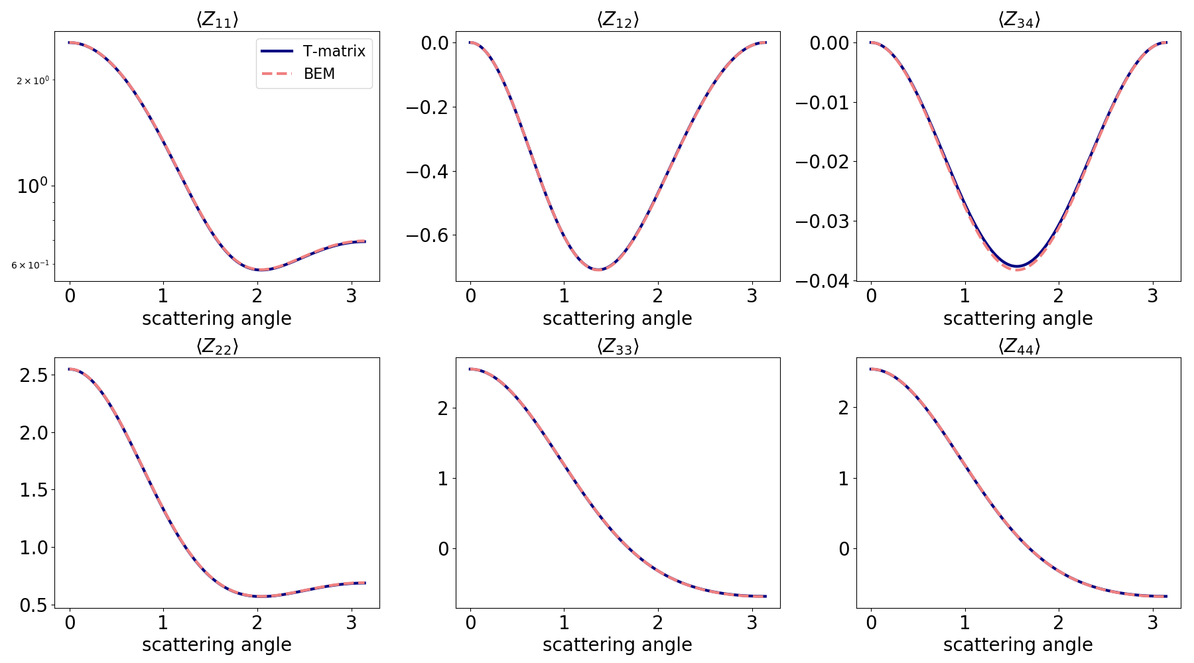
Testing our method – X=1
Notes:
X=1
14 incident waves
10 rotations of the polarisation vectors

Slide 39
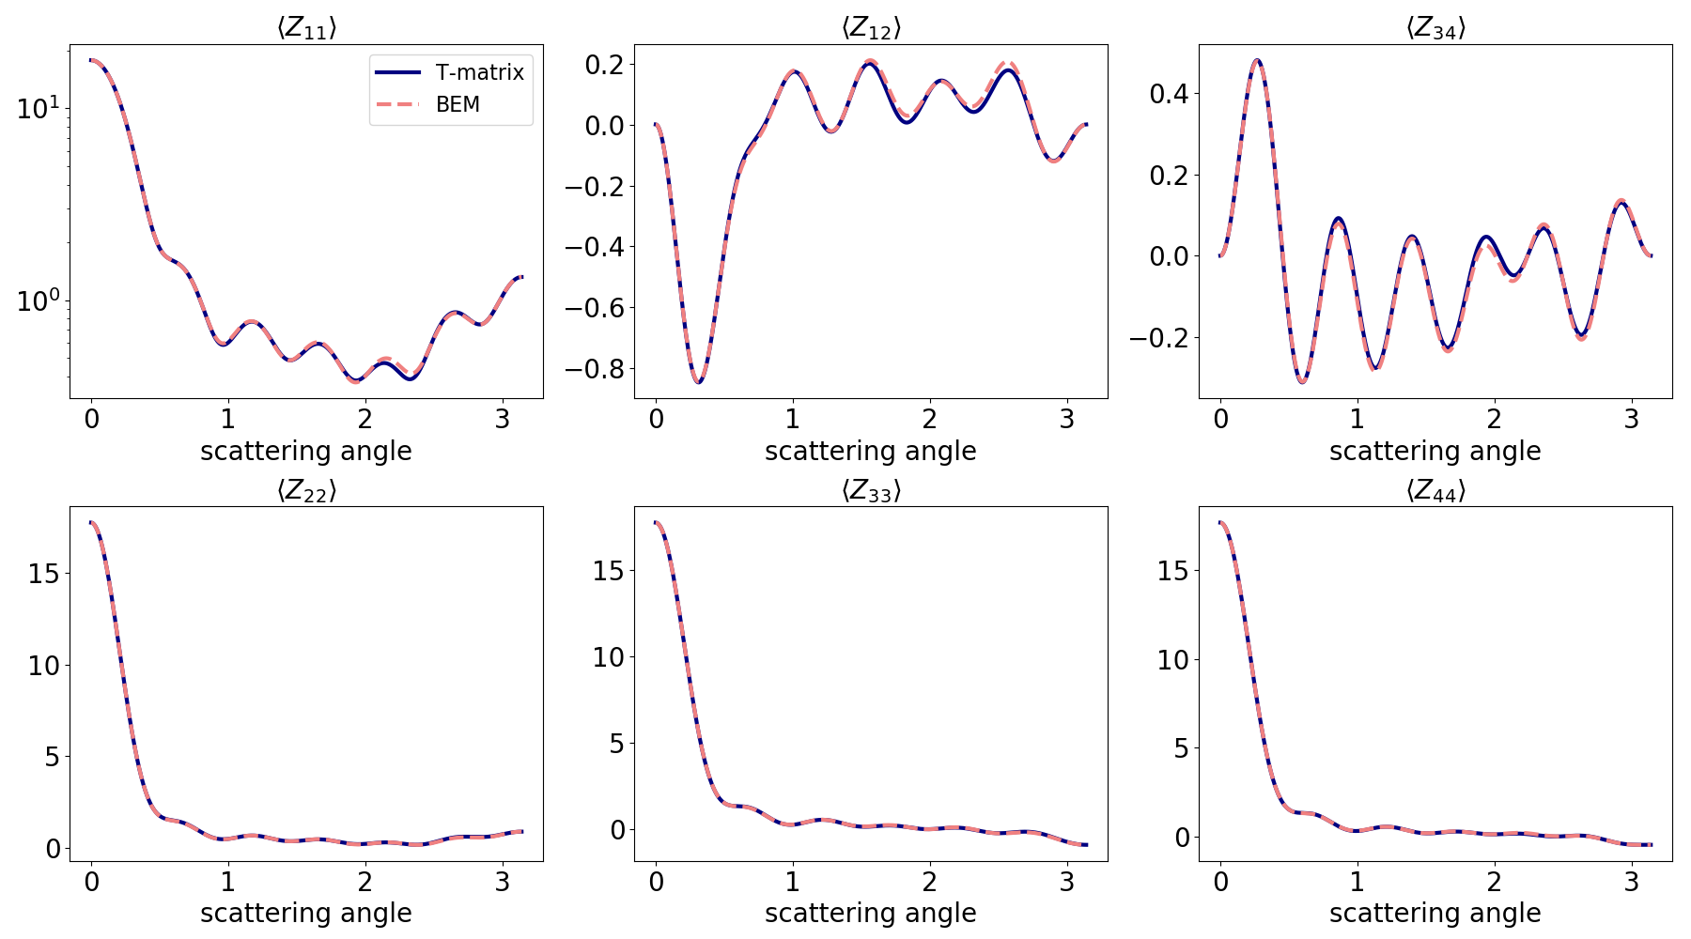
Testing our method – X=5
Notes:
X=5
110 incident waves
10 rotations of the polarisation vectors

Slide 40
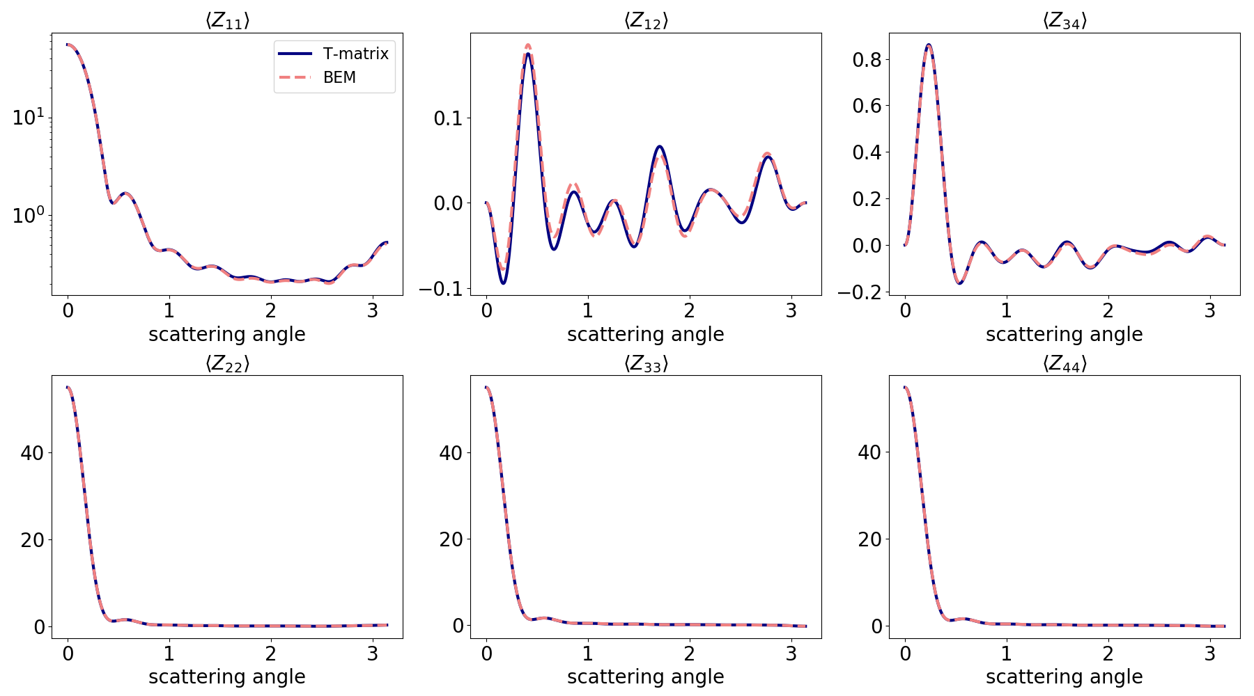
Testing our method – X=10
Notes:
X=10
194 incident waves
15 rotations of the polarisation vectors

Slide 41
Testing our method
To obtain SSPs to within accuracies of 10% or so, (Liu, et al., 2008), using the discrete dipole approximation (DDA), found that 17 x 16 x 16 (4352) orientations were required to simulate random orientation.
With our method we can reduce the number of incident waves and rotations of the polarisation vectors needed depending on the size parameter of the aggregate.
To accurately compute the SSPs within accuracy of 1-5% we need
X<1: 14 incident directions
1<X<3: 50 incident waves
3<X<5: 110 incident waves
5<X<8: 194 incident waves
8<X<10: 230 incident waves
X>10: 302 incident waves
To obtain the phase matrix to 1-2% relative error we also need:
X<1: 10 rotations of the polarisation vectors
1<X<24: 15 rotations of the polarisation vectors
X>24: 20 rotations of the polarisation vectors

Slide 42
Part III: Scattering by inhomogeneous particles
Antigoni Kleanthous, University College London, UK
Timo Betcke, University College London, UK
David Hewett, University College London, UK
Anthony Baran, The Met Office, UK & University of Hertfordshire, UK

Slide 43
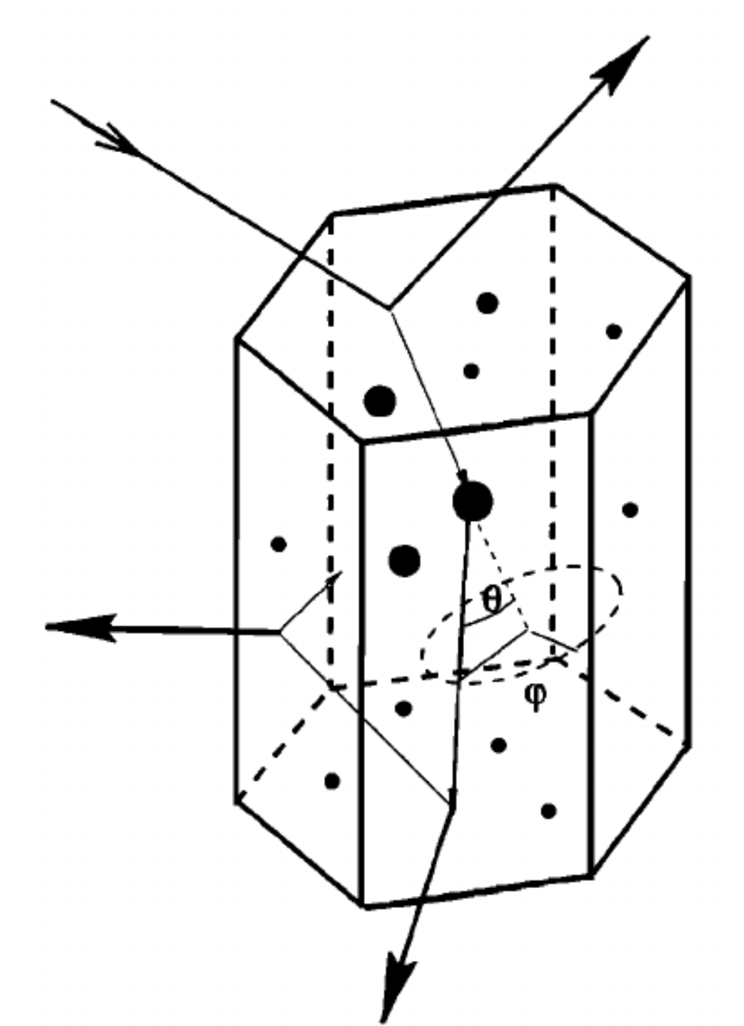
Inhomogeneous scatterers
The boundary integral formulation and preconditioning can be easily extended to simulate scattering by inhomogeneous scatterers
Hexagonal columns with air bubbles
Ice crystal in a liquid droplet
Notes:
- Inhomogeneous Hexagonal monocrystal
– ice crystals falling through the atmosphere

Slide 44
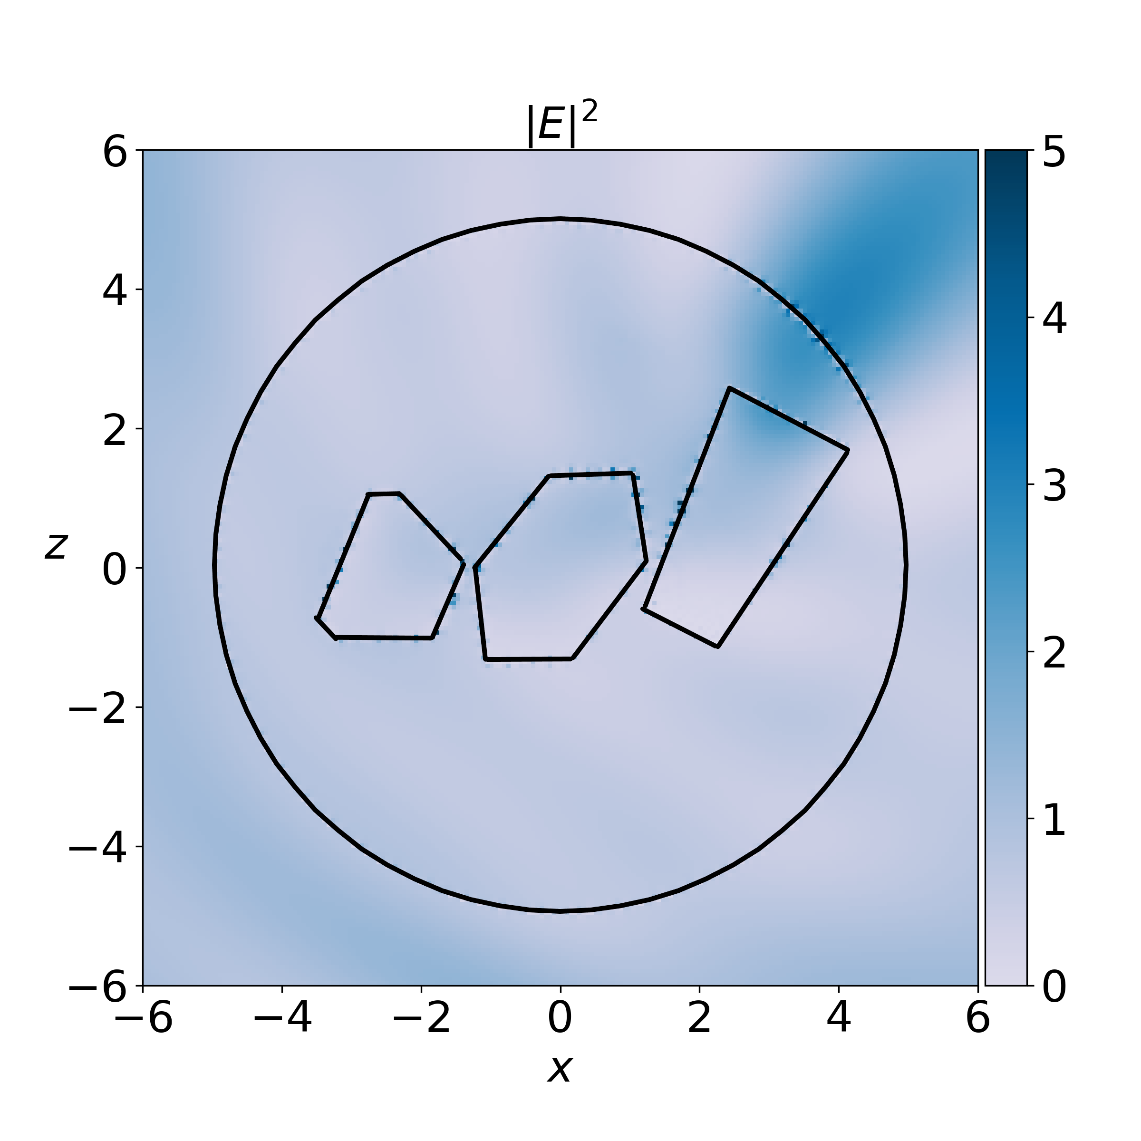
Notes:
8-branch aggregate in a liquid sphere, 50GHz

Slide 45
Future Steps
Complete simulations for the database to include phase matrix calculations
Time permitting, explore scattering by inhomogeneous scatterers

